Slide 1
Making Informed Choices About Your Retirement Plan
Presented by StanCorp Equities, Inc., member FINRA
Notes:
Today we’re going to talk about retirement plan fees.
To get the most out of your retirement plan, it’s important that you make informed decisions about investment options. Fees affect investment earnings, which in turn affects how much money you can eventually accumulate for retirement.

Slide 2
Presented by…
[Presenter’s name]
[Presenter’s title]
[Presenter’s name]
[Presenter’s title]
Notes:
I am [name] with The Standard and [partner name if applicable] is with me.

Slide 3
Your Retirement Plan’s Benefits
Your retirement plan offers benefits that other savings vehicles may not:
Pre-tax contributions
Access to quality funds
Buying power
Higher contribution limits
©2011 Standard Retirement Services, Inc. What You Need To Know About Fees
Notes:
Before we discuss fees, I want to briefly cover some of the benefits of your plan. First of all, why save for retirement? The simple answer is that you will eventually have to retire –one way or another –and Social Security likely will not be enough to fully fund it. Your retirement plan is one of the best places to save tax-deferred dollars for retirement. Your contributions will be deducted on a pre-tax basis – before taxes are withheld – which may reduce your income taxes and out-of-pocket cost of contributing to the plan. Keep in mind that withdrawals from tax-deferred accounts are subject to federal, and if applicable, state income tax. [INCLUDE IF MATCH: Your company might also provide a match to boost your total savings which is like free money in the bank.]
In your plan, you will have access to a diverse lineup of quality mutual funds that are carefully selected and closely monitored to ensure they perform as expected. In addition, your retirement plan offers strength in numbers. When you and your co-workers enroll, your plan gains the benefit of enhanced buying power. Because a plan contains the retirement assets of many investors, employers can often negotiate lower fees from the plan provider and mutual fund providers. This benefit of “strength in numbers” does not apply when investing in an IRA. When comparing a retirement plan to an IRA, you have higher contribution limits in your retirement plan. This means you set aside more in a retirement plan. Plus, there are no fee disclosure requirements for IRAs.

Slide 4
Your Retirement Plan’s Benefits
Retirement plans are regulated
Your employer is required to consider and review the plan’s fees
Retirement plan fiduciaries have important responsibilities and are subject to standards of conduct because they act on behalf of participants in a retirement plan and their beneficiaries. (Source: www.dol.gov/ebsa/publications/ fiduciaryresponsibility.html)
©2011 Standard Retirement Services, Inc. What You Need To Know About Fees
Notes:
Another benefit to you are the regulations that are in place to protect people participating in retirement plans. In fact, retirement plans are one of the most regulated of all your employer benefits.
As a “fiduciary” of the plan, your employer is held to a very high standard. In that role, your employer is required to:
Consider the fees and expenses paid by your plan to ensure fees are reasonable for the services provided to you
Regularly review and assess fees for competitiveness
[OPTIONAL DETAIL] The Department of Labor’s definition of a fiduciary is anyone who exercises discretionary authority or discretionary control over management or administration of the plan, exercises any authority or control over management or disposition of plan assets, or gives investment advice for a fee or other compensation with respect to assets of the plan.

Slide 5
Fee Basics
Fees have always existed
Regulatory changes instituted for your benefit
How The Standard approaches fees
©2011 Standard Retirement Services, Inc. What You Need To Know About Fees
Notes:
Fees are not new. They have always been a part of retirement plans and other savings vehicles. The Department of Labor requires service providers to show a high level of detail regarding fees. The requirements are intended to help retirement plan investors make more informed decisions when choosing investment options available in their plan and using services that incur additional fees (for example, loans and withdrawals). Fees displayed in your materials are in compliance with the regulations. The Standard has always had full fee transparency and remains committed to this practice.

Slide 6
Fee Basics
What do fees pay for?
Administration and operations
Investment management and transactions
Keeping the plan in legal compliance
People managing the plan behind the scenes
©2011 Standard Retirement Services, Inc. What You Need To Know About Fees
Notes:
Some fees pay for services that directly benefit you such as the Personal Savings Center website where you can manage your account online, your quarterly account statement, and enrollment and education materials and sessions like this one. Other fees pay for services that happen behind the scenes like those related to investment options and keeping the plan in compliance with mandatory government regulations. These fees are shared by you and your employer. [RM: Please note if this sponsor passes all fees back to participant and adjust accordingly.] Sharing this cost is not uncommon. For example, you and your employer share in the fees for Social Security as well as your health-care benefits. There are also a number of service providers involved in the day-to-day operation of your retirement plan who get paid from the fees you and your employer pay.
[OPTIONAL DETAIL]
•Investment advisors handle the monitoring and selection of your investment options.
•The recordkeeper or third-party administrator tracks your contributions, interest earnings, distributions, and so forth.
•Custodians physically hold the assets.
•Trustees manage the assets for the benefit of those enrolled in the plan.
•Auditors ensure that the plans are compliant with Department of Labor and Internal Revenue Service regulations.
•Legal or tax counsel may assist with resolving legal issues associated with the plan and also documenting the plan’s features.
•Investment company or mutual funds companies manage the investment options in the plan.
•Other professionals may provide legal, audit, education and reporting services.

Slide 7
Fee Basics
Two Types:
Investment Fees
Administration Fees
©2011 Standard Retirement Services, Inc. What You Need To Know About Fees
Notes:
There are two types of fees:
Those related to investment options
Those associated with running the plan, which are also known as administration fees
Some fund companies and providers charge transaction fees. The amount of and conditions for these fees vary by each investment option. We’ll go into detail on the next slide.

Slide 8
Investment Fees
Cover investment management and other investment-related services
Generally a percentage of invested assets
Deducted directly from your investment returns
©2011 Standard Retirement Services, Inc. What You Need To Know About Fees
Notes:
The first type of fees are investment or asset-based fees.
Most of the fees that you are charged fall into this category. They cover a variety of investment management services, such as buying and selling stocks and bonds within the mutual funds, regularly monitoring the mutual funds, and allocating the interest earnings every day.
FOR GA PLANS only:
These fees are generally deducted from your investment returns as a percentage of the invested assets.
FOR ALL PLANS
With mutual funds, your net total return is your return after investment fees have been deducted.
FOR GA PLANS only:
You can always access your account online through Personal Savings Center to view all of the investment-related expenses in your plan.

Slide 9
Investment Fees
Redemption fees
Company stock fund fees
©2011 Standard Retirement Services, Inc. What You Need To Know About Fees
Notes:
[OPTIONAL SLIDE]
Some mutual fund companies have established redemption fees for investors selling shares of a mutual fund before a specified time period. These fees are charged when a fund is sold and are used to discourage frequent trading, which drives up the cost of managing a mutual fund.
Redemption fees are usually eliminated after someone participating in the plan has held the shares of a mutual fund for a certain period of time, which could be 30, 60 or 90 days -- or more. You can see redemption fees online at the Personal Savings Center website and on your quarterly account statements.
You might be able to avoid paying these fees by waiting to sell this type of investment until after the redemption fee time period has passed.
Company stock fund fees are charged for buying and selling company stock. Smart investor tip: If your employer allows, you may be able to reduce these fees by buying/selling company stock in larger amounts or less frequently.

Slide 10
Investment Fees
Mutual fund fees
Front-end load
Back-end load
Rule 12b-1 fees
©2011 Standard Retirement Services, Inc. What You Need To Know About Fees
Notes:
FOR NAV PLANS only:
Some other common mutual fund fees you may have heard about are front-end loads, which means you pay fees up front when you invest in a mutual fund. This fee may reduce your initial investment.
Back-end loads mean you pay fees when you sell shares. The back-end load fee is based on how long you have kept the investment; some decrease or disappear over time.
Some funds charge 12-b1 fees that are paid out of the fund assets to cover the cost needed to maintain the fund. These fees may replace front- or back-end loads.

Slide 11
Investment Fees
Brokerage windows
Individual stocks, bonds
Other investment products
Investment advice
Account management services
©2011 Standard Retirement Services, Inc. What You Need To Know About Fees
Notes:
[Optional slide for NON-MANAGED PLANS]
Brokerage windows are optional services offered by some employers to give employees access to a greatly increased lineup of investment options. Through a brokerage window, employees can invest in individual stocks, bonds and other investment products not usually available through a retirement savings plan.
Generally there are annual as well as transaction fees associated with these services. For most people, the investment options offered through their basic plan services provide the diversification they need to meet their retirement planning goals.
Investment advice is sometimes offered as an optional service to people participating in the plan. It can be a cost-effective alternative to expensive private financial and investment counseling.
Account management services are offered by some plans, often at a fraction of what it would cost to obtain similar services elsewhere. The fees associated with investment management services may be money well spent for investors who want to eliminate time and worry.
[If account management service being offered is Mainspring Managed] Mainspring Managed is The Standard’s formal, goals-based savings and investment plan. If you choose Mainspring Managed, The Standard will manage both your savings rate and investment allocation.
This type of service may be appropriate for investors who:
Are looking for professional investment selection
Don’t have time to monitor and rebalance regularly
Don’t feel comfortable making investment selections

Slide 12
Administration Fees
Cover such items as:
Account access and statements
Educational meetings and materials
Day-to-day plan administration
Investment and consulting guidance
Recordkeeping
Regulatory compliance and plan audits
©2011 Standard Retirement Services, Inc. What You Need To Know About Fees
Notes:
As mentioned, some fees pay for services that directly benefit you such as the Personal Savings Center website where you can manage your account online, your quarterly account statement, and enrollment and education materials and sessions like this one. These are administration fees.
Other types of administration fees include:
Day-to-day plan administration
Investment and consulting guidance
Recordkeeping, such as tracking contributions, distributions, and so forth
Mandatory regulatory compliance and plan audits

Slide 13
Where To Find Fee Information
In an annual notice
On your quarterly account statement
At your request, online at www.standard.com/retirement
©2011 Standard Retirement Services, Inc. What You Need To Know About Fees
Notes:
Where will you see fees? As of summer 2012, fee detail will appear:
Annually, in a notice
Quarterly, on your account statement
Any time you wish by going online at www.standard.com/retirement

Slide 14
Where To Find Fee Information: Annually
Variable Return Investments
Name/type of option | Average Annualized Total Return as of 12/31/XX |  |  |  | Benchmark |  |  |  | Mutual Fund Expenses | The Standard’s Asset Base Fees | Total Operating Expenses |  | *Shareholder-type fees
 | 1 yr | 5 yr | 10 yr | Since incep-tion | 1 yr | 5 yr | 10yr | Since Incep-tion |  |  | As a % | Per $1,000
Equity Funds
A Index Fund / S&P 500 | XX.XX% | XX.XX% | XX.XX% | XX.XX% | XX.XX% | XX.XX% | XX.X% | XX.XX% | XX.XX% | XX.XX% | XX.XX% | $XX.XX | 2% redemption fee if sold within 90 days
 |  |  |  |  | S&P 500
B Fund / Large Cap | XX.XX% | XX.XX% | XX.XX% | XX.XX% | XX.XX% | XX.XX% | XX.X% | XX.XX% | XX.XX% | XX.XX% | XX.XX% | $XX.XX
 |  |  |  |  | US Prime Market 750 Index
C Fund / Intl. Stock | XX.XX% | XX.XX% | XX.XX% | XX.XX% | XX.XX% | XX.XX% | XX.X% | XX.XX% | XX.XX% | XX.XX% | XX.XX% | $XX.XX
 |  |  |  |  | MSCI EAFE
D Fund / Mid Cap | XX.XX% | XX.XX% | XX.XX% | XX.XX% | XX.XX% | XX.XX% | XX.X% | XX.XX% | XX.XX% | XX.XX% | XX.XX% | $XX.XX
 |  |  |  |  | Russell Midcap
Bond Funds
E Fund / Bond Index | XX.XX% | XX.XX% | XX.XX% | XX.XX% | XX.XX% | XX.XX% | XX.X% | XX.XX% | XX.XX% | XX.XX% | XX.XX% | $XX.XX
 |  |  |  |  | Barclays Cap Aggr. Bond
Sample
* This table shows the fees elected by the fund. You may not be charged this full amount depending on individual circumstances.
Notes:
[FOR GA PLANS ONLY]
This table will appear in your annual notice. It shows the Total Annual Operating Expenses of each investment option. These expenses reduce the rate of return of the investment option. Where applicable, amounts shown in the column for The Standard’s Asset Based fee (HIGHLIGHTED ON TABLE) include a credit for payments that fund companies pay to The Standard.
This table also shows shareholder-type fees, which are in addition to the Total Annual Operating Expenses. You may not be charged some of these shareholder-type fees, depending on the fund companies’ policies with respect to qualified plans, and your individual circumstances. Information about an option’s principal risks as well as other important information is available on www.standard.com/retirement

Slide 15
Where To Find Fee Information: Annually
Name/type of option | Average Annualized Total Return as of 12/31/XX |  |  |  | Benchmark |  |  |  | Total Operating Expenses |  | *Shareholder-type fees
 | 1 yr | 5 yr | 10 yr | Since inception | 1 yr | 5 yr | 10yr | Since Inception | As a % | Per $1,000
Equity Funds
A Index Fund / S&P 500 | XX.XX% | XX.XX% | XX.XX% | XX.XX% | XX.XX% | XX.XX% | XX.XX% | XX.XX% | XX.XX% | $XX.XX | 2% redemption fee if sold within 90 days
 |  |  |  |  | S&P 500
B Fund / Large Cap | XX.XX% | XX.XX% | XX.XX% | XX.XX% | XX.XX% | XX.XX% | XX.XX% | XX.XX% | XX.XX% | $XX.XX
 |  |  |  |  | US Prime Market 750 Index
C Fund / Intl. Stock | XX.XX% | XX.XX% | XX.XX% | XX.XX% | XX.XX% | XX.XX% | XX.XX% | XX.XX% | XX.XX% | $XX.XX
 |  |  |  |  | MSCI EAFE
D Fund / Mid Cap | XX.XX% | XX.XX% | XX.XX% | XX.XX% | XX.XX% | XX.XX% | XX.XX% | XX.XX% | XX.XX% | $XX.XX
 |  |  |  |  | Russell Midcap
Bond Funds
E Fund / Bond Index | XX.XX% | XX.XX% | XX.XX% | XX.XX% | XX.XX% | XX.XX% | XX.XX% | XX.XX% | XX.XX% | $XX.XX
 |  |  |  |  | Barclays Cap Aggr. Bond
Sample
* This table shows the fees elected by the fund. You may not be charged this full amount depending on individual circumstances.
Notes:
[FOR NAV PLANS ONLY]
This table will appear in your annual notice. It shows the Total Annual Operating Expenses of each investment option. These expenses reduce the rate of return of the investment option.
This table also shows shareholder-type fees, which are in addition to the Total Annual Operating Expenses. You may not be charged some of these shareholder-type fees, depending on the fund companies’ policies with respect to qualified plans, and your individual circumstances. Information about an option’s principal risks as well as other important information is available on www.standard.com/retirement.

Slide 16
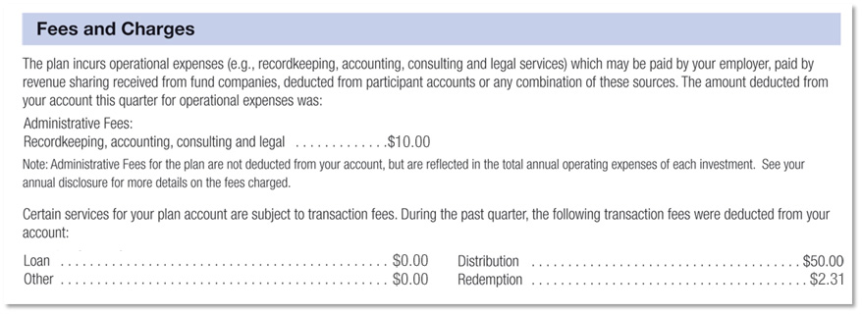
Where To Find Fee Information: Quarterly
©2011 Standard Retirement Services, Inc. What You Need To Know About Fees
Notes:
INCLUDE FOR GA PLANS ONLY
This slide shows how administrative fees will be displayed on your account statement. The top section focuses on recordkeeping, consulting and legal fees while the bottom covers transaction fees such as distributions, loans, account management and more.

Slide 17
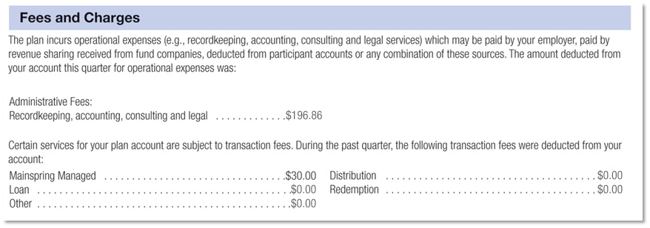
Where To Find Fee Information: Quarterly
©2011 Standard Retirement Services, Inc. What You Need To Know About Fees
Notes:
INCLUDE FOR NAV PLANS ONLY
This slide shows how administrative fees will be displayed on your account statement. The top section focuses on recordkeeping, consulting and legal fees while the bottom covers transaction fees such as distributions, loans, account management and more.

Slide 18
Best Practices
Know what fees you are paying
Decide whether additional or enhanced services, such as investment advice, represent a good value
©2011 Standard Retirement Services, Inc. What You Need To Know About Fees
Notes:
Here are a few best practices that can help keep your costs down and maximize opportunities for savings growth.
Know what fees you are paying
Know and understand the fees charged to your account. [OPTIONAL] For example, you may be able to avoid paying unnecessary redemption fees by holding securities the required minimum period whenever possible.
Decide whether additional or enhanced services represent a good value for you. Cheap isn’t always better. It may be in your best interests to pay more for added or better services.
These simple steps can go a long way toward helping you get the maximum benefits from your retirement savings plan.

Slide 19
Your Retirement Income
Social Security may not be enough to fund your retirement
Your retirement plan lets you save pre-tax, which lowers your taxable income
Your employer may provide a contribution match, which is free money
The more you save now, the longer your money has to grow
©2011 Standard Retirement Services, Inc. What You Need To Know About Fees
Notes:
To summarize the benefits of your retirement, Social Security may not be enough to fully fund your retirement income.
With a retirement plan, you save on pre-tax dollars. Your employer may provide a contribution match, which can help to boost your savings. And, it’s free money.
You can also tap into the power of compounding interest. The money you save in your retirement plan earns interest. Then, you can earn interest on the money you saved plus on the interest you've accumulated. The more you save now, the longer your money has to grow.

Slide 20
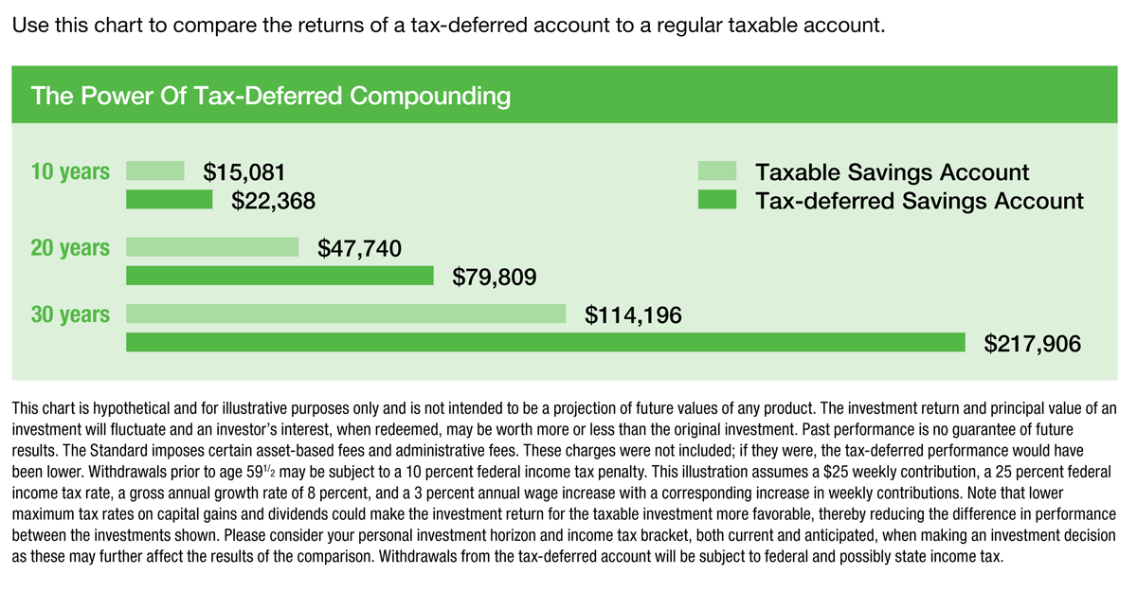
The Power Of Your Account
This chart is hypothetical and for illustrative purposes only and is not intended to be a projection of future values of any product. The investment return and principal value of an investment will fluctuate and an investor’s interest, when redeemed, may be worth more or less than the original investment. Past performance is no guarantee of future results. The Standard imposes certain asset-based fees and administration fees. These charges were not included; if they were, the tax-deferred performance would have been lower. Withdrawals prior to age 59 ½ may be subject to a 10 percent federal income tax penalty. This illustration assumes a $25 weekly contribution, a 25 percent federal income tax rate, a gross annual growth rate of 8 percent, and a 3 percent annual wage increase with a corresponding increase in weekly contributions. Note that lower maximum tax rates on capital gains and dividends could make the investment return for the taxable investment more favorable, thereby reducing the difference in performance between the investments shows. Please consider your personal investment horizon and income tax bracket, both current and anticipated, when making an investment decision as these may further affect the results of the comparison. Withdrawals from the tax-deferred account will be subject to federal and possibly state income tax.
©2011 Standard Retirement Services, Inc. What You Need To Know About Fees
Notes:
Why not start saving today? If you’re already enrolled, think about increasing the amount you save.
As this chart illustrates, it pays to start earlier rather than later when it comes to saving. Even a small amount can make a big difference over time.

Slide 21
Thank you! Questions?

Slide 22
Plan sponsors and participants should carefully consider the investment objectives, risks, charges and expenses of the investment options offered under the retirement plan before investing. The prospectuses for the individual mutual funds and each available investment option in the group annuity contain this and other important information. Prospectuses may be obtained by calling 877.805.1127. Please read the prospectus carefully before investing. Investments are subject to market risk and fluctuate in value.
The Standard is the marketing name for StanCorp Financial Group, Inc. and its subsidiaries. StanCorp Equities, Inc., member FINRA, distributes group annuity contracts issued by Standard Insurance Company and may provide other brokerage services. Third-party administrative services are provided by Standard Retirement Services, Inc. Investment advisory services are provided by StanCorp Investment Advisers, Inc., a registered investment advisor. StanCorp Equities, Inc., Standard Insurance Company, Standard Retirement Services, Inc., and StanCorp Investment Advisers, Inc. are subsidiaries of StanCorp Financial Group, Inc. and all are Oregon corporations.
Copyright © 2011 Standard Retirement Services, Inc. All rights reserved
RP 15931 (1/12)

