Slide 1
Saving for Tomorrow
Retirement on the Brain
Notes:
[1 Click for Animation]
Welcome.
You’re here today because your employer offers a retirement plan. It’s a great way to save now to cover your living expenses in the future.
You may or may not be enrolled in your plan, but either way, one big question may be on your mind.
“How much should I save?”
If this feels like a big question to tackle, put your worries aside.
Today, we’re going to move together through some simple steps to help you come up with an answer.

Slide 2
Why Aren’t We Saving for Retirement?
I don’t know how much to save.
It’s too hard to get started.
I'm close to retiring. It's too late to start saving.
I'm hoping I'll be fine on my Social Security benefits.
Retirement is still a long ways off.
Notes:
Saving for retirement can feel challenging. A lot of us feel that way.
While many Americans have access to a workplace retirement plan, they may not feel ready for retirement.
Why aren’t we saving for retirement?
The reasons may sound familiar to you. Which of these do you hear in your head?
“It’s too hard to get started.”
“Retirement is a long ways off.”
“I’m close to retiring. It’s too late to start saving.”
“I’m hoping I’ll be fine on my Social Security benefits.”
“I don’t know how much to save.”
We’ll talk more in a bit about some of these reasons – and how we can easily help you get past them.

Slide 3
Reasons to Save
Money for Major Purchases
Money to Live On
Money for Fun
Notes:
Let’s talk about what your costs will be when you are retired.
When you stop working and stop getting a regular paycheck, you’ll still have some of the same expenses you have now. And new ones, too.
Here’s what you’ll need:
Money to live on
Rent or mortgage
Food and necessities
Utilities and other expenses
Insurance
Transportation
Money for fun
Travel expenses
Club memberships
Hobbies and activities
Money for major purchases
Car
Home projects
Real estate
Technology, like new phones and computers
How will you cover these expenses?

Slide 4
More Reasons to Save
Replaces only 40% of current salary
May rise by almost 5.5% a year
Averages 3% a year
Health Care
Inflation
Social Security Benefits
Notes:
There are a few other important reasons to be saving.
[1 Click for Animation Showing Stats]
Health-care costs are a big one.
Retiree health care costs are expected to rise by nearly 5.9% throughout one’s retirement years.*
So give some thought about how you will pay to stay healthy in retirement.
And what about inflation?
The cost of everything we buy and services we use typically increase year over year. Generally, we expect that things will cost more when you retire, compared to what they cost today.
For those of you who plan to retire on your Social Security benefits, remember that these benefits are not designed to cover all of your needs in retirement.
How will you make up the difference?

Slide 5
Why Join Your Plan
Automatic Savings
Tax Advantages
Investment Options
Compounding
Employer Match
(if available)
Notes:
[1 Click for Animation]
So let’s look back at one of the reasons we aren’t saving.
“It’s too hard to get started” is one I hear a lot.
But the reality is your employer’s retirement plan is easy to join. It takes just minutes to get online and enroll – with any amount.
It’s easy to change your contribution when you decide to increase your savings rate. You can make changes any time.
And tracking your balance and investments doesn’t take a lot of effort.
Need more reasons to enroll in your plan? Here are 5 of the best ones:
It’s easy – saving is automatic. Contributions to your retirement plan are taken directly out of your paycheck. This makes saving easy and seamless.
There are big tax advantages. Your contributions are made before taxes are withheld. This reduces your taxable income and income taxes.
You have control over your investments. You decide how and where to invest. And you can take your savings with you if you leave your job.
Compounding is cool. The earnings on your savings are reinvested and start earning an investment return of their own. The earlier you start saving, the more you’ll benefit from compounding.
“Free money.” OK, not really, but your employer may match part of your contribution. That means you may be able to double your contributions up to a limit.
[1 Click for Animation to Next Slide]

Slide 6
Why Join Your Plan
Automatic Savings
Tax Advantages
Investment Control
Compounding
Employer Match
Notes:
So let’s look back at one of the reasons we aren’t saving.
“It’s too hard to get started” is one I hear a lot.
But the reality is your employer’s retirement plan is easy to join. It takes just minutes to get online and enroll – with any amount.
It’s easy to change your contribution when you decide to increase your savings rate. You can make changes any time.
And tracking your balance and investments doesn’t take a lot of effort.
Need more reasons to enroll in your plan? Here are 5 of the best ones:
It’s easy – saving is automatic. Contributions to your retirement plan are taken directly out of your paycheck. This makes saving easy and seamless.
There are big tax advantages. Your contributions are made before taxes are withheld. This reduces your taxable income and income taxes.
You have control over your investments. You decide how and where to invest. And you can take your savings with you if you leave your job.
Compounding is cool. The earnings on your savings are reinvested and start earning an investment return of their own. The earlier you start saving, the more you’ll benefit from compounding.
“Free money.” OK, not really, but your employer may match part of your contribution. That means you may be able to double your contributions up to a limit.

Slide 7
How Much
How much will you need in your retirement?
80 to 90 percent of your current income!
Say the experts.
Notes:
So how much will you need in retirement?
Experts generally agree that most of us will need 80 to 90 percent of our current income to live a similar lifestyle in retirement.
Will you need closer to 80 percent or more like 90 percent? That’s hard to predict.
Some of us plan to retire easy, maybe downsize to a smaller house with fewer expenses and work in the garden as much as we can.
Others might have plans to travel for six months out of the year to far off destinations or buy a second house in a warmer part of the country.
Spend a few minutes picturing what you might do in your retirement? Do you think you’ll want to:
Travel far
Earn a degree
Volunteer for your favorite non-profit
Complete projects in your home
Play golf
Work part-time
How you might spend your retirement will help determine how much you’ll need financially.

Slide 8
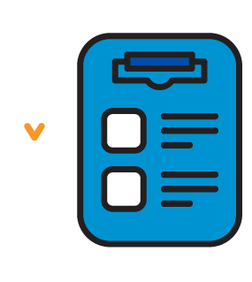
Checklist
Notes:
Let’s take a quick quiz to help you get even closer to figuring out how much you’ll need in retirement.
Then we’ll be a step closer to our goal – figuring out how much to save now.

Slide 9
Answer 6 Questions
0
If the answer is “Less”
1
If the answer is “Same”
2
If the answer is “More”
Notes:
I’m going to ask you questions about these 6 topics.
Use this scoring system for each answer and keep track as we go along.
Add 0 if your answer is Less
Add 1 is your answer is Same
Add 2 if your answer is More
[1 Click for Animation to Next Slide]

Slide 10
Answer 6 Questions
Debt
0
If the answer is “Less”
Mortgage/Rent
1
Travel
If the answer is “Same”
Major Purchases
2
If the answer is “More”
Entertainment
Health Care
Notes:
Here are the questions. [1 Click for each question ]
Do you think you’ll have less, the same or more debt in retirement than you have now? (Think about loans, credit cards, etc.)
When you’re retired, will your mortgage or rent payment be less, the same or more than now?
What about travel? Will you do less, the same or more when you’re retired?
Think about major purchases. Do you think you’ll be making fewer, the same or more big purchases in retirement? (Ex. Remodel house, computer, car, beach home, new roof.)
Do you plan to spend less, more or the same on entertainment and other recreational activities?
And what about health care and other insurance. Do you think you’ll be spending less, the same or more when you’re no longer working?
[1 Click for last check mark]

Slide 11
Scoring Your Quiz
Score
Approximate Percentage
of Current Income Needed
0-4
80%
5-7
90%
8-10
100%
11-12
110%
Notes:
Look for your total score on the left and find your percentage. Maybe you came up with 80%.
Multiply that percentage with your current annual income to get a dollar amount.
This is an estimate of what you’ll need to live on each year in retirement.
The next step is figuring out how much to save now so you can reach that goal. I can help you do that next.

Slide 12
Saving Mileposts
Notes:
We’ve consulted expert sources to find these suggested guidelines for saving when you’re 30, 45 and 60.
As an example, the ideal target savings goal for a 45-year-old is 15 to 20 percent of your paycheck.
You’re in good shape if you have 3.5 times your current annual salary already saved in a retirement account.

Slide 13
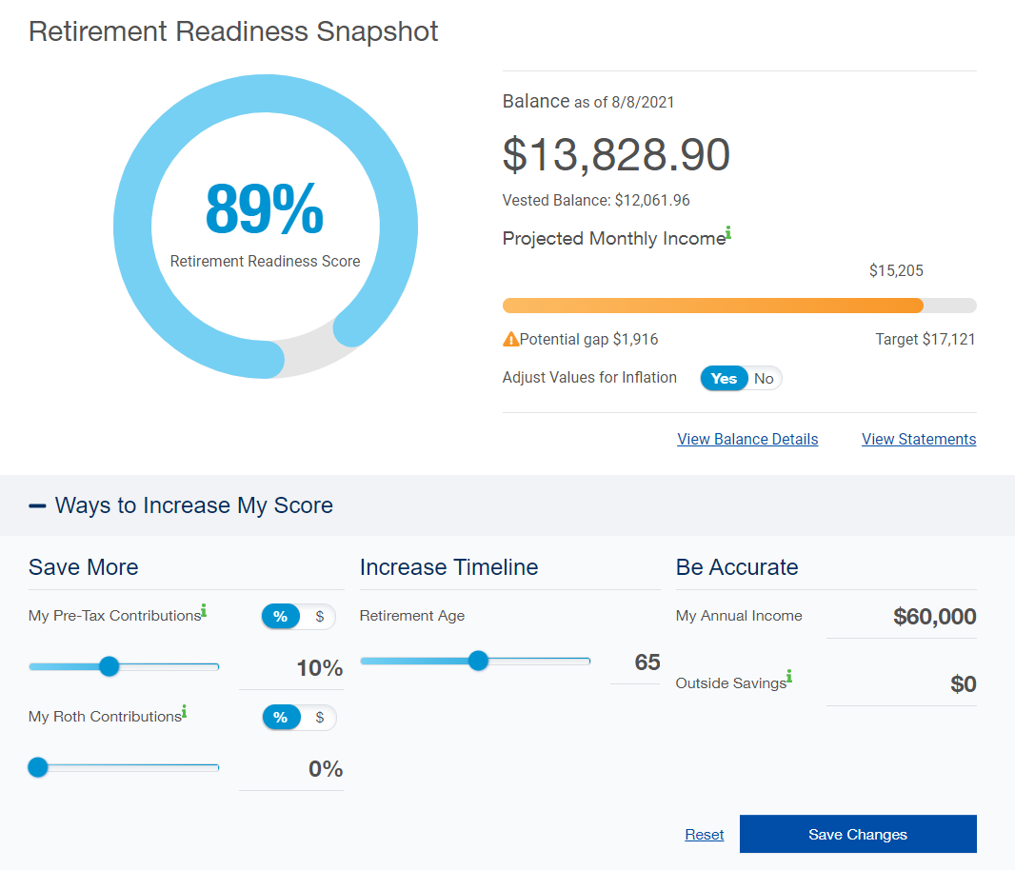
Saving for Tomorrow
‭Visit www.standard.com/retirementto see your Retirement Readiness Snapshot.
Notes:
We know that many of you came here wondering how much you should save.
If you visit standard.com/retirement, you can log in to your Personal Savings Center account. There you’ll see a helpful Retirement Readiness Snapshot. By adjusting the sliders and adding your income and outside savings, you can see how much you need to save for the future.
You may discover that you can afford to contribute on a regular basis. Investing even a small amount of your pay can make a big difference at retirement.
To save more, simply click Save Changes.
If you haven’t enrolled yet, you can click Save Changes to be quickly enrolled in the plan’s default investment at the contribution you choose. Or you can enroll online the regular way.
The sooner you start saving, the easier it will ‭be to prepare for retirement.
Thank you for your time

Slide 14
Conclusion
For educational purposes only. Nothing in this presentation should be considered investment advice.
Employers and plan participants should carefully consider the investment objectives, risks, charges and expenses of the investment options offered under the retirement plan before investing. The prospectuses for the individual mutual funds in the group annuity contain this and other important information. Prospectuses may be obtained by calling 877.805.1127. Please read the prospectus carefully before investing. Investments are subject to market risk and fluctuate in value.
The Standard is the marketing name for StanCorp Financial Group, Inc., and its subsidiaries. StanCorp Equities, Inc., member FINRA, wholesales a group annuity contract issued by Standard Insurance Company and a mutual fund trust platform for retirement plans. Standard Retirement Services, Inc., provides financial recordkeeping and plan administrative services. Investment advisory services are provided by StanCorp Investment Advisers, Inc., a registered investment adviser. StanCorp Equities, Inc., Standard Insurance Company, Standard Retirement Services, Inc., and StanCorp Investment Advisers, Inc., are subsidiaries of StanCorp Financial Group, Inc., and all are Oregon corporations.
RP 19356
(8/21)

