Slide 1
The Power of a Budget Find Money to Save
Retirement on the Brain
Notes:
Welcome.
You’re here today because your employer offers a retirement plan to help you save for the future.
It’s a terrific opportunity to prepare for retirement. But a large percentage of us don’t contribute.
One of the main reasons is that after taking care of our financial needs, we don't feel like we have much left to invest. So how do we find money to save for retirement?
This is our topic for today.

Slide 2
Speakers
First Last Name
Title, The Standard
First Last Name
Title, The Standard
Retirement on the Brain
Notes:
[INTRODUCTIONS]

Slide 3
Reasons to Save
Money for Major Purchases
Money to Live On
Money for Fun
Notes:
Why is saving for retirement important?
Well, when we stop getting a regular paycheck, we still have to cover many of the same expenses we have now. And some new ones, too.
In retirement, we need:
Money to live on
Rent or mortgage
Food and necessities
Utilities and other expenses
Insurance
Transportation
Medical expenses
Money for fun
Travel expenses
Club memberships
Hobbies and activities
Money for major purchases
Car
Home projects
Real estate
Technology, like new phones and computers
How will you cover these expenses?

Slide 4
Join Your Company’s Retirement Plan
Retirement on the Brain
Notes:
One of the best answers is to join your company’s retirement plan.

Slide 5
Why Join Your Plan?
Automatic Savings
Tax Advantages
Investment Options
Compounding
Employer Match
Notes:
[1 Click for Animation]
Here are 5 of the best reasons to enroll in your plan:
It’s easy – saving is automatic. Contributions to your retirement plan are taken directly out of your paycheck. This makes saving easy and seamless. And you can take your savings with you if you leave your job.
There are big tax advantages. Your contributions are made before taxes are withheld. This reduces your taxable income and income taxes.
We've screened and evaluated the investment options in your plan during a thorough review process. This helps ensure that you have a diverse and appropriate selection of options to choose from.
Compounding happens. The earnings on your savings are reinvested and start earning an investment return of their own. The earlier you start saving, the more you’ll benefit from compounding
“Free money.” Your employer may match part of your contribution. That means you may be able to double your contributions up to a limit.
[1 Click for Animation to Next Slide]

Slide 6
Get Rid of Roadblocks to Retirement Readiness
Retirement on the Brain
Notes:
OK, we’ve reviewed the important reasons to save for retirement.
We’ve talked about the hard-to-ignore reasons to join your retirement plan.
It’s time to get rid of roadblocks to saving, whatever they might be, and focus on a great way to find money to save.

Slide 7
Start Here: Create a Budget
You control your money, rather than letting your money control you.
Retirement on the Brain
Notes:
Start by creating a budget
Creating a budget is powerful.
A budget helps you control your money, rather than letting your money control you.
It gives you the power to spend and save in the smartest ways possible.
Whether you’re new to the workforce or more settled in your career. Whether you’re already careful about money or more laid-back about spending.
And did you know that people who set a goal are more likely to meet it?
A budget can show you how to manage your debt, save for the future and live comfortably in the present.

Slide 8
Budgeting Basics
Track your income
Compare it to your expenses
Find ways to come out ahead
Retirement on the Brain
Notes:
Simply put, a budget is an easy way to:
Track your income
See how your earnings compare to your expenses
Find ways to spend money on what's important to you and save for the future
Your goals may be to save for a trip to Italy in the next year. Or add to a college fund for your kids.
A major goal should be setting money aside for retirement.

Slide 9
Less Stress
A budget helps you:
Build savings
Look for ways to spend less
Meet long-term goals
Get out of debt
Build self-discipline
Source: Mint
Retirement on the Brain
Notes:
If you’re like many of us, creating a budget might not be at the top of your list of favorite things to do.
For some of us, it’s up there with doing your taxes and trying to figure out what health insurance to sign up for.
But when you think about it, creating a budget can help you feel less stress and more in control of your financial state. Think about these benefits:
A budget helps you build savings. It keeps you from overspending on the extras, so you end up with a cash surplus at the end of each month.
A budget motivates you to look for ways to save money. It’s not just about looking for expenses that you can eliminate. It can move you to figure out where you can find cost savings. For example, you might decide to call your cable company to negotiate a lower monthly rate. The monthly savings will add up and you can spend it in other ways.
At the end of the month, you can set aside any surplus cash for that big trip or new house or for retirement.
A budget helps you get out of debt. It shows you how much you can afford if you want to get out of debt faster. Paying a little more each month for a car loan, for example, means you might end your loan sooner.
A budget helps you build self-discipline. Once you start following a budget, your new habits will become routine. This will eventually lead to more cash in your pocket – and less stress.
Source: Mint

Slide 10
What’s Your Budgeting Style?
Keep it simple
Get online
Download an app
Retirement on the Brain
Notes:
There’ve never been so many easy ways to create a budget.
Here are 3 ways to get started:
Keep it simple. Just start writing things down. Keep a financial record on paper by doing these three things:
Track your income.
Track your expenses and your debt, and see how they compare with your earnings.
Find ways to spend less than you earn and save the excess for retirement.
2. Get online. Create a computer spreadsheet to track your earnings and spending. A simple Excel or Google Sheets document will work. Share the spreadsheet with others in your family to track your household spending habits and see where you might trim expenses.
3. Download an app. Budgeting apps are convenient and many of them are free. They can help you spend and save wisely, pay your bills and invest your earnings.

Slide 11
There's an App for That
Mint (free)
Wally (free)
You Need a Budget
PocketGuard
Goodbudget
Mvelopes
The companies listed here are not associated with or endorsed by The Standard.
Retirement on the Brain
Notes:
Here are a few budgeting apps that get good reviews. Some are free and some are not.
They’re attractive because they literally keep your budget at your fingertips.
Each one offers something a little different, so you’ll want to do a little research to find the one that fits your needs. For example, some connect to your bank account. This lets you easily track everything you buy, check your account balances on a regular basis and pay your bills.
Other apps let you know when you’ve reached a savings goal. Like if you’ve been putting aside money for that trip to Italy. The app can let you know when you’ve reached your goal and it’s time to start booking the trip.

Slide 12
Application Example
Rachel
24 years old
Earns $40K a year
Wants to save money for retirement
Retirement on the Brain
Notes:
Let’s consider an example.
Rachel is early in her career and just starting to think about enrolling in her company’s retirement plan.
She signs up for a budgeting app so she can track her spending and find money to contribute to a retirement account.

Slide 13
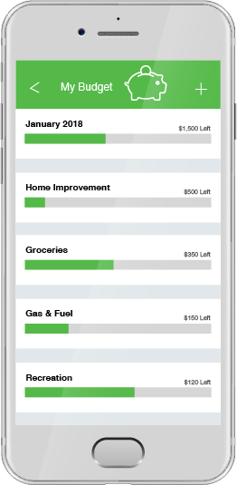
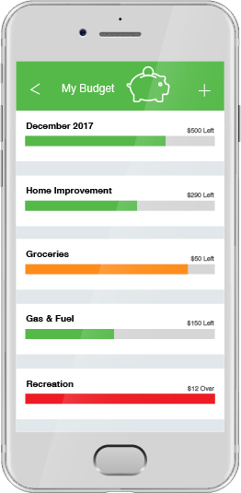
Application Interface
Retirement on the Brain
Notes:
When Rachel started tracking her spending by categories, she was surprised at how much she was spending on gas and restaurant lunches each week.
She started taking the bus to work instead of driving and brought a lunch from home twice a week.
She put the amount she saved into her retirement plan.
She also started relying on the budgeting app to let her know when bills were due, so she could avoid late fees. By connecting the app to her checking account, she could keep track of her account balances and avoid overspending on extras.

Slide 14
How Budgeting Helped Me
“A budget makes me think twice about buying more stuff. I’m putting aside money for a big trip, so saving money is always on my mind.”
- Marie, 55
“I uncovered all of these ‘ghost payments,’ charges for things I no longer used. I got rid of them and it felt like I found extra money.”
- Sara, 38
“I’ve been focused on paying off my student loans. After creating a budget, I realized I could afford to do that and save for retirement.”
- Tyler, 27
Retirement on the Brain
Notes:
Creating a budget can be an eye-opening experience for many people. For some, it does leave them feeling less stressed about their finances.
Here’s what some people have said after they’ve started budgeting.
[READ QUOTES]

Slide 15
Ready for Retirement
Retirement on the Brain
Notes:
No matter which budgeting method you choose, the benefit is the same:
Budgeting can help you focus on saving for the important goals in your life. A comfortable retirement should be one of them.

Slide 16
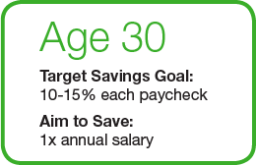
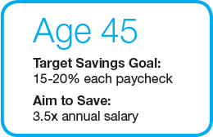
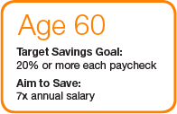
Saving Mileposts
Notes:
We’ve consulted expert sources to come up with these suggested guidelines for saving when you’re 30, 45 and 60.
As an example, the ideal target savings goal for a 30-year-old is 10 to 15 percent of your paycheck.
You’re in good shape if you've already saved at least the amount of your current annual salary.

Slide 17
Questions?
Go to standard.com/retirement to enroll in your plan or increase your contribution.
Retirement on the Brain
Notes:
I hope we’ve given you ideas about budgeting and finding money to save for retirement.
If you don’t already follow a budget, give a budgeting app a try. Or set up a spreadsheet to keep track of your family’s spending.
With a solid budget, you should find it easier to enroll in your retirement plan or increase your contribution.
When it comes time to retire, you’ll be happy you took the time to crunch the numbers.
Here’s where to go to enroll: standard.com/retirement
Thank you for being here today. I’m here to answer questions.

Slide 18
The standard
RP19459 12/17

