Slide 1




Investing to Match Your Taste
Choose options that mix well with your appetite for risk
Retirement on the Brain
Notes:
Your employer offers a retirement plan to help you prepare for the future.
Whether you’re already enrolled or still thinking about signing up, we understand that the idea of picking investments can be overwhelming.
Today we’re going to help you with that. We’ll be discussing:
Your appetite for risk when it comes to investing for retirement
The three types of investment choices
Managing risk through diversification

Slide 2


Speakers
First Last Name
Title, The Standard
First Last Name
Title, The Standard
Retirement on the Brain
Notes:
[INTRODUCTIONS]

Slide 3
Reasons to Save for Retirement
Money for
Major Purchases
Money to Live On
Money for Fun
Retirement on the Brain
Notes:
First, let’s talk about why saving for retirement is important.
You’re working now. But when you retire and stop getting a regular paycheck, you’ll still have to cover many of the same expenses you have now. And possibly some new ones, too.
Here’s what you’ll probably need:
Money to live on
Rent or mortgage
Food and necessities
Utilities and other expenses
Insurance
Transportation
Medical expenses
Money for fun
Travel expenses
Club memberships
Hobbies and activities
Money for major purchases
Car
Home projects
Real estate
Technology, like new phones and computers
Think about how you will cover these expenses?

Slide 4

Your retirement plan gives you the freedom to choose your investments
Retirement on the Brain
Notes:
Investing money in your retirement plan now can help you grow the savings you’ll need to live on in retirement.
The sooner you start saving, the easier it can be. Starting early gives your money time to compound. That’s when the earnings on your savings are reinvested and begin earning an investment return of their own.
Another great thing about your retirement plan is that you can choose how your money is invested. And choosing investments doesn’t have to be complicated.

Slide 5


What is risk? Risk refers to the chance that you could lose money. As you invest for retirement, it’s a good idea to review your appetite for risk.
Notes:
Investing always comes with some risk. Risk refers to the chance that you could lose money.
As you invest for retirement, it’s a good idea to review your appetite for risk. When you know how much you can stomach, you can better match your investments with your risk tolerance and savings goals.
Generally, if you’re early in your career and just starting to save, you probably have a greater tolerance for risk because your investments have more time to grow.
If you’re closer to retiring, you may prefer less risky investments to keep your account balance more constant.

Slide 6


Your Fresh Investment Choices
Cash Equivalents
• Stable asset funds
• Money market funds
+ Potential gain: Consistent, lower returns
– Potential risk: Slow growth may not make sense for a longer investment timeframe
Bonds
• Bonds
• Bond mutual funds
+ Potential gain: Consistent, moderate returns
– Potential risk: Moderate growth may not make sense for a longer term investment
timeframe
Stocks
• Stocks
• Stock mutual funds
+ Potential gain: High return potential
– Potential risk: High, which may not make sense for a shorter term investment timeframe
Retirement on the Brain
Notes:
There are three basic investment choices. Stocks come with the most risk but offer the highest potential return. Cash equivalents offer low risk but relatively low returns. Bonds fall in the middle.
Let’s look at the types of investments and how you can make or lose money with each.

Slide 7
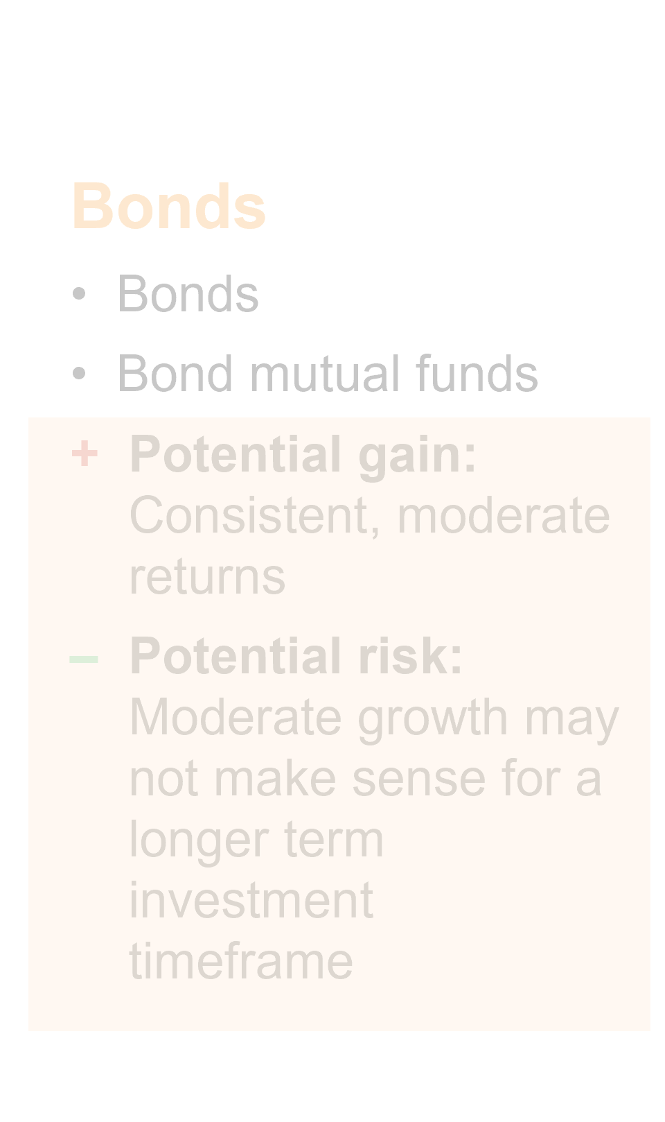
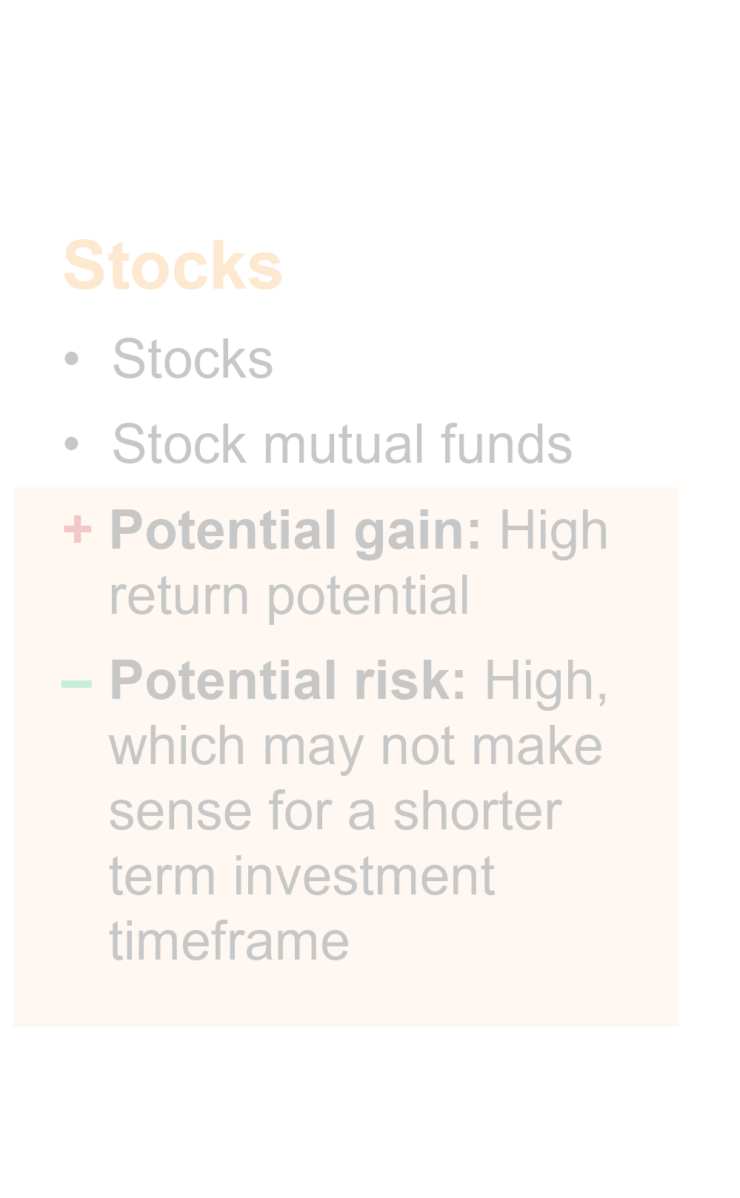
Cash Equivalents
Cash Equivalents
• Stable asset funds
• Money market funds
+ Potential gain: Consistent, lower returns
– Potential risk: Slow growth may not make sense for a longer investment timeframe
Retirement on the Brain
Notes:
Cash equivalents are investments that allow you to earn interest income and a return on your principal.
A stable asset fund is one example. It gives you a guaranteed return and an appealing crediting rate.
Other types of cash equivalents are money market funds.
There is low risk of losing money with cash equivalents.

Slide 8
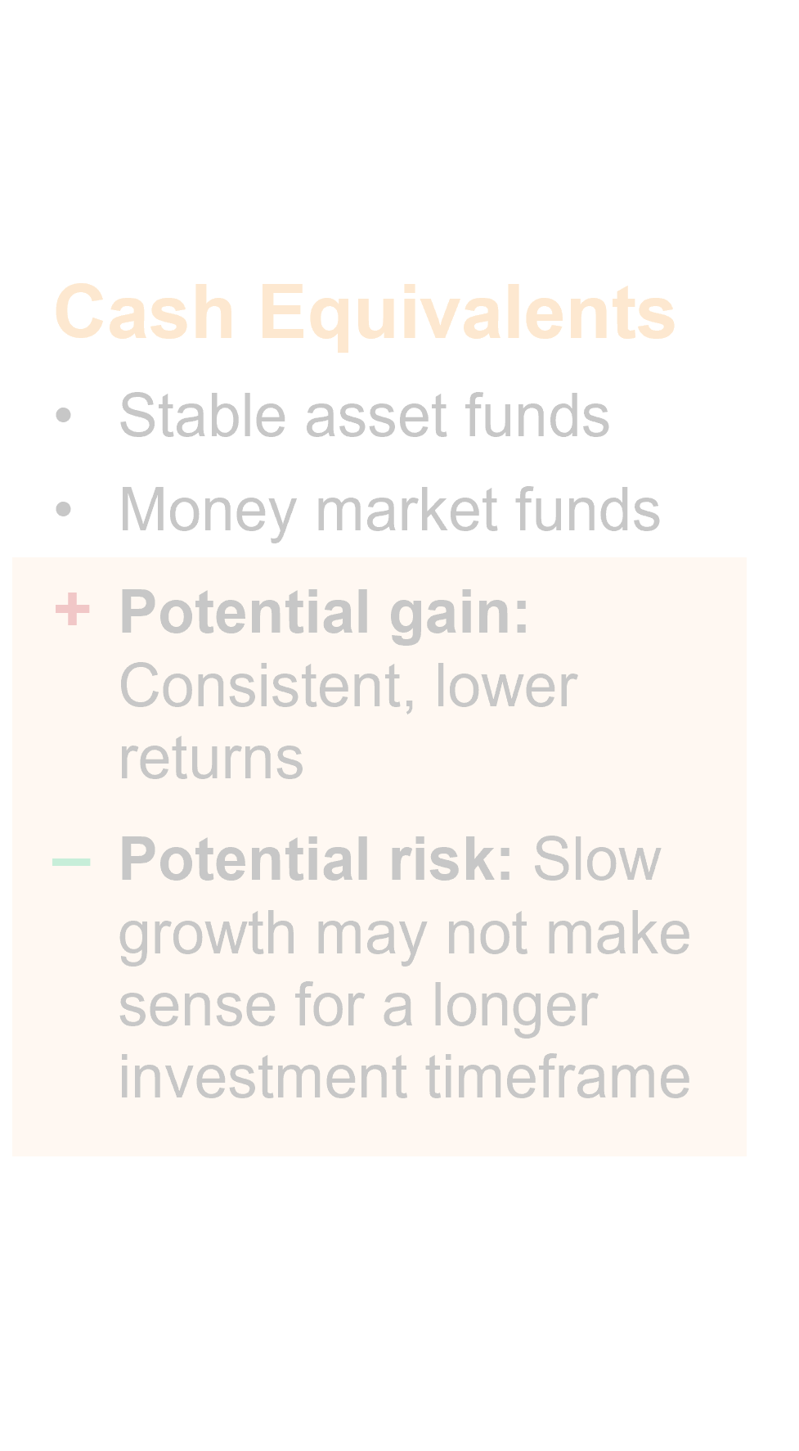
Bonds
Bonds
• Bonds
• Bond mutual funds
+ Potential gain: Consistent, moderate returns
– Potential risk: Moderate growth may not make sense for a longer term investment
timeframe
Retirement on the Brain
Notes:
Bonds are in the middle of the risk spectrum.
Companies, the U.S. government and other government agencies sell bonds to raise money. When you buy a bond, you’re lending money to the issuer for a set period of time.
Bond issuers pay interest to investors, which is how you earn money on your investment. You can also make money if you sell a bond before its maturity date for more than you paid for it.
You can lose money on bonds if you sell them for less than what you paid. It’s possible to lose money in a bond if the issuer has severe financial problems and can’t repay the debt.

Slide 9
Stocks
Stocks
• Stocks
• Stock mutual funds
+ Potential gain: High return potential
– Potential risk: High, which may not make sense for a shorter term investment timeframe
Retirement on the Brain
Notes:
Stocks have the highest risk but also the highest potential for making money. Companies sell stock to investors to raise money. When you buy shares of a stock in a company, you become one of the owners.
You can make money on stocks by selling shares for more than you paid. Some companies also pay stockholders regular dividends.
You can lose money on stocks if you sell shares at a lower price than you paid. You can also lose money if the company issuing the stock goes bankrupt or decreases in value.

Slide 10
Risks and Returns
Cash Equivalents
Bonds
Stocks
Potential Risk
Potential Return
Retirement on the Brain
Notes:
This chart shows the potential for risk and return for each of the types of investments.

Slide 11
Mix it up. Whether you’re hungry for risk or just want a taste of it, spreading your money over different investment groups is key to managing risk.
Notes:
Whether you have a strong appetite for risk or think of yourself as a more conservative investor, diversification is key to managing investment risk.
Diversification means spreading your money to different investments.
You can also diversify within investment groups. Most mutual funds, for example, are automatically diversified. For example, a stock fund may include stocks in many companies with the potential for both losses and gains.
With diversification, the losses you may experience from poorly performing stocks may be balanced out by stocks that perform better than expected.
But remember that diversification doesn’t guarantee a profit or protect against loss in a declining market.

Slide 12
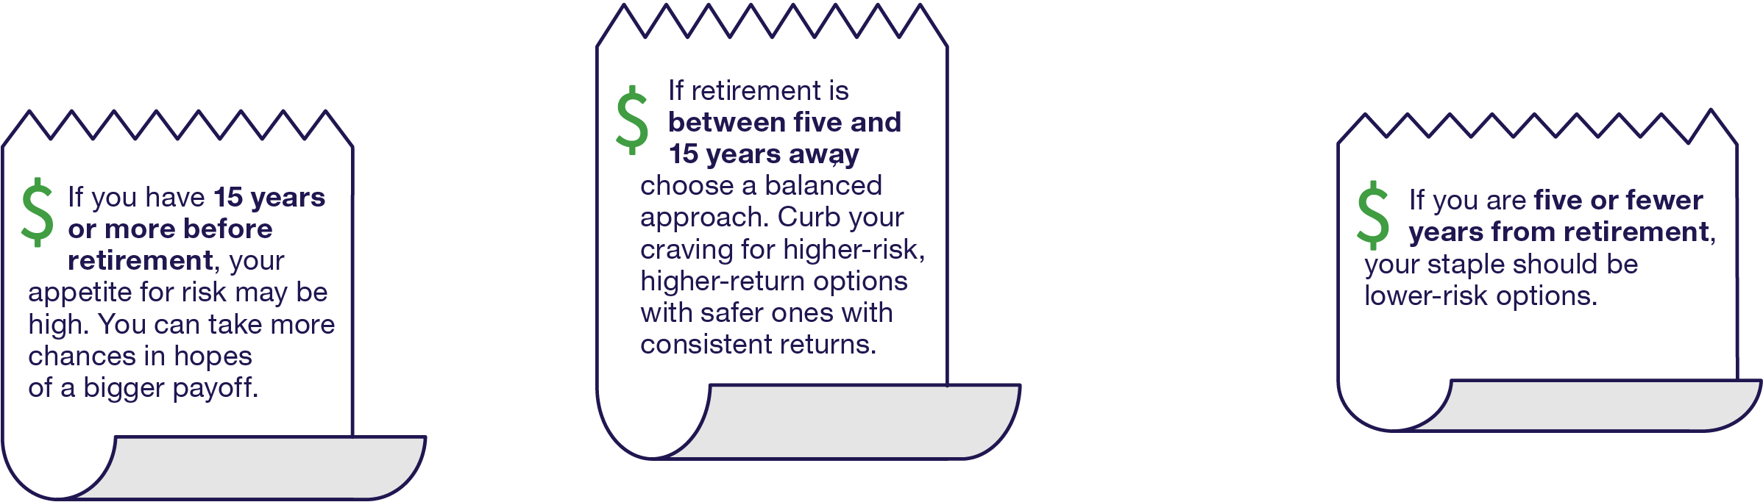
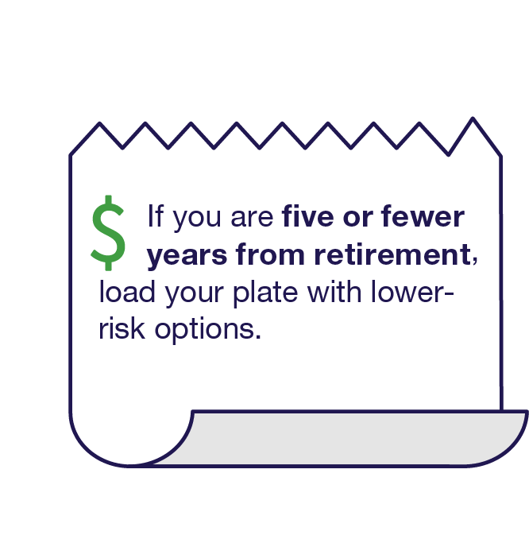


How Many Years Before You Retire?
Retirement on the Brain
Notes:
The number of years you have before retirement can definitely influence your appetite for risk.
If you have 15 years or more before retirement, your appetite for risk may be high. You can take more chances in hopes of a bigger payoff.
If retirement is between five and 15 years away, choose a balanced approach. Even out your craving for higher-risk, higher-return options with safer ones that have more consistent returns.
If you are five or fewer years from retirement, your staple should be lower-risk options.

Slide 13
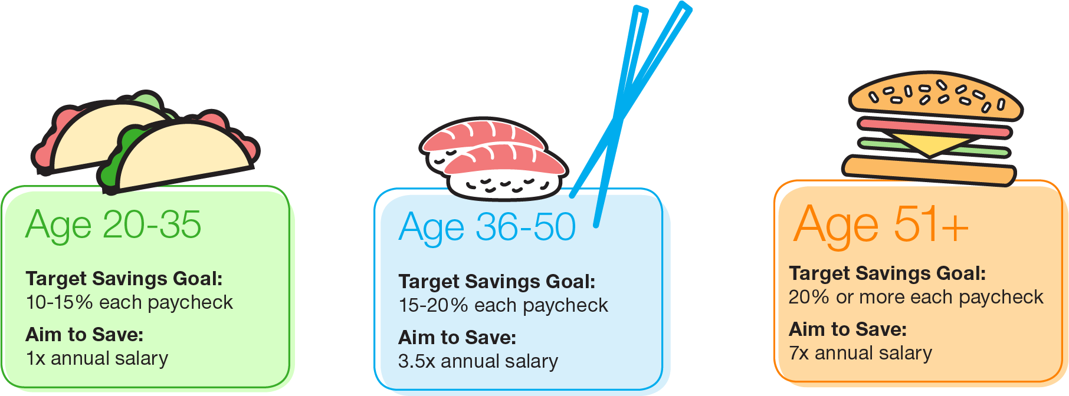
How Much to Save?
Retirement on the Brain
Notes:
Check out these guidelines to saving for retirement at each life stage.
For example, the ideal target savings goal for a 45-year-old is 15 to 20 percent of your paycheck.
At this age, you’re in good shape if you have 3.5 times your current annual salary already saved in a retirement account.

Slide 14

Why Join Your Plan?
Automatic
Savings
Tax
Advantages
Investment
Options
Compounding
Employer
Match
Retirement on the Brain
Notes:
[1 Click for each animation]
If you haven't enrolled in your employer's plan, here are five of the best reasons to sign up today:
It’s easy – saving is automatic. Contributions to your retirement plan are taken directly out of your paycheck. This makes saving easy and seamless. And you can take your savings with you if you leave your job.
There are tax advantages. Your contributions are made before taxes are withheld. This reduces your taxable income and income taxes.
Your plan's investment options have been put through a comprehensive review process. This helps ensure that you have a diverse and appropriate selection of options to choose from.
Compounding happens. The earnings on your savings are reinvested and start earning an investment return of their own. The earlier you start saving, the more likely you'll benefit from compounding.
“Free money.” Your employer may match part of your contribution. That means you may be able to double your contributions up to a limit.

Slide 15
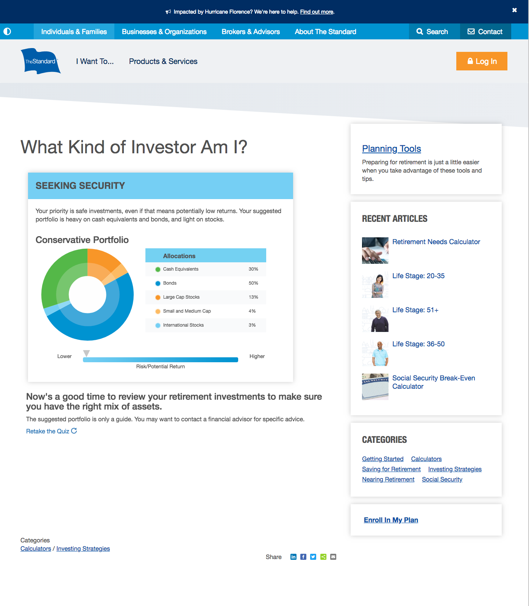
What Kind of Investor Are You?
Take our quiz to find out.
Go to standard.com/investorquiz
Retirement on the Brain
Notes:
To learn more about your appetite for risk and what kind of investor you are, take our quiz. Go to standard.com/investorquiz

Slide 16

Questions?
Order up! Enroll in your retirement plan or increase your contribution. Go to standard.com/retirement
Retirement on the Brain
Notes:
When you’re ready, here’s where to go to enroll in your retirement plan or increase your current contribution:
standard.com/retirement
Thank you for being here today. I’m here to answer questions.

Slide 17
End of Presentation
Employers and plan participants should carefully consider the investment objectives, risks, charges and expenses of the investment options offered under the retirement plan before investing. The prospectuses for the individual mutual funds in the group annuity contain this and other important information. Prospectuses may be obtained by calling 877.805.1127. Please read the prospectus carefully before investing. Investments are subject to market risk and fluctuate in value.
The Standard is the marketing name for StanCorp Financial Group, Inc., and its subsidiaries. StanCorp Equities, Inc., member FINRA, wholesales a group annuity contract issued by Standard Insurance Company and a mutual fund trust platform for retirement plans. Standard Retirement Services, Inc. provides financial recordkeeping and plan administrative services. Investment advisory services are provided by StanCorp Investment Advisers, Inc., a registered investment advisor. StanCorp Equities, Inc., Standard Insurance Company, Standard Retirement Services, Inc., and StanCorp Investment Advisers, Inc., are subsidiaries of StanCorp Financial Group, Inc., and all are Oregon corporations.
RP 20137 (10/18)

