Slide 1
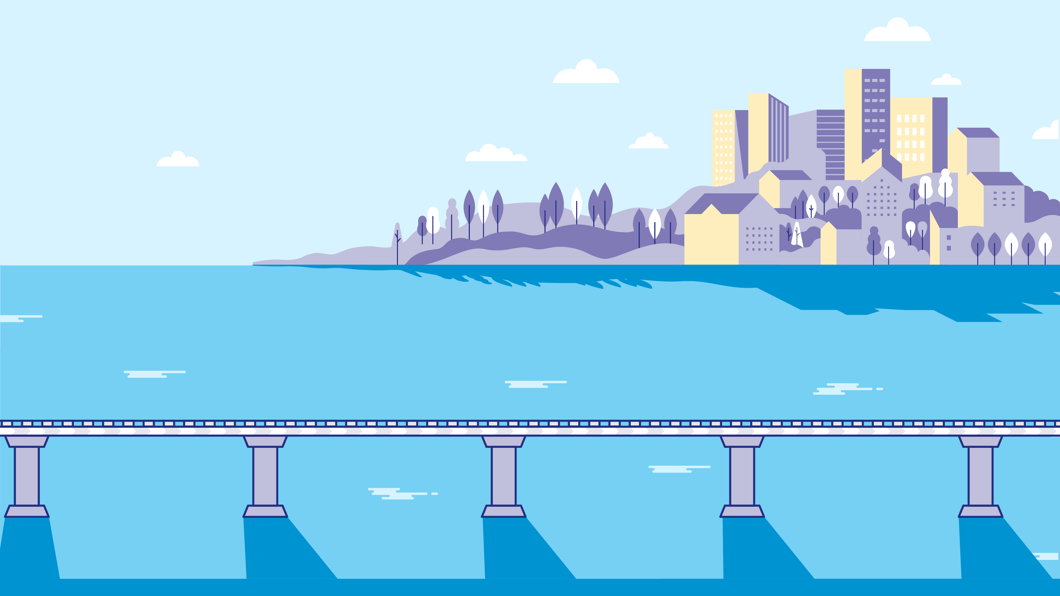
Retirement on the Brain
MOVING TOWARD
RETIREMENT
Notes:
Welco me.
You’ve probably already thought about retirement and done some planning, but most of us could also use a bit more guidance to make sure our retirement plan is on track. What are the factors that should be considered?
Today we're going to help you by looking at some options when thinking about retirement:
• Setting a retirement age goal
• Catching up on saving
• Looking at Social Security benefits
• Considering life span, inflation and medical expenses
• Choosing the right mix of investments
• Managing your plan
Let’s get started.

Slide 2
Introductions
RM
NAME
Relationship Manager
Notes:
[Option for speaker introduction]

Slide 3
Your Timetable for Retirement
How Much Money Will You Spend in Retirement?
EXAMPLE FOR $60,000 ANNUAL INCOME
75% - 85%
OF YOUR CURRENT INCOME
Expect to spend $45,000 to $50,000 per year in retirement.
Notes:
When planning for retirement, you’ll need to figure out how much money you’ll be spending in retirement.
Many financial planners say most retirees will spend between 75% to 85% of their current income in retirement.
So, if you spend $60,000 a year while working, you can expect to spend about $45,000 to $50,000 a year in retirement.
You’ll need money for rent or mortgage, food and necessities, utilities, and other expenses.
Taxes, debt, medical expenses and other costs could make the amount you will spend more or less.

Slide 4
Your Timetable for Retirement
How Much Income Can You Expect?
4%
EXAMPLE GOAL OF $1M IN RETIREMENT SAVINGS
SETTING A RETIREMENT GOAL
SAFELY WITHDRAW $40,000/YR
OF YOUR SAVINGS
EACH YEAR
The age when you’ll have enough savings to cover retirement spending.
This assumes an annual rate of return of 4%.
Notes:
The second question to answer is: How much income can you expect in retirement?
Retirement income can come from your retirement savings, social security or other sources, which we’ll cover in a bit.
A rule of thumb is you can draw about 4% of your savings each year and still maintain your savings thorough retirement.
For example, if you have $1 million saved, you should be able to withdraw $40,000 a year and your savings will last throughout retirement.
You should only retire when you have enough savings and benefits to cover your retirement spending needs. When you can reach that savings goal will be your target retirement age.
To set a retirement age, you’ll need to calculate when you’ll have enough savings to regularly withdraw the amount you’ll need to live on. If you’ll have other sources of income in retirement, you can rely a bit less on your savings.

Slide 5
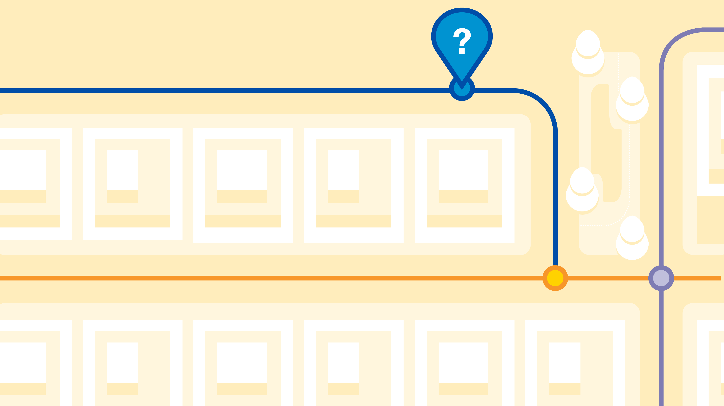
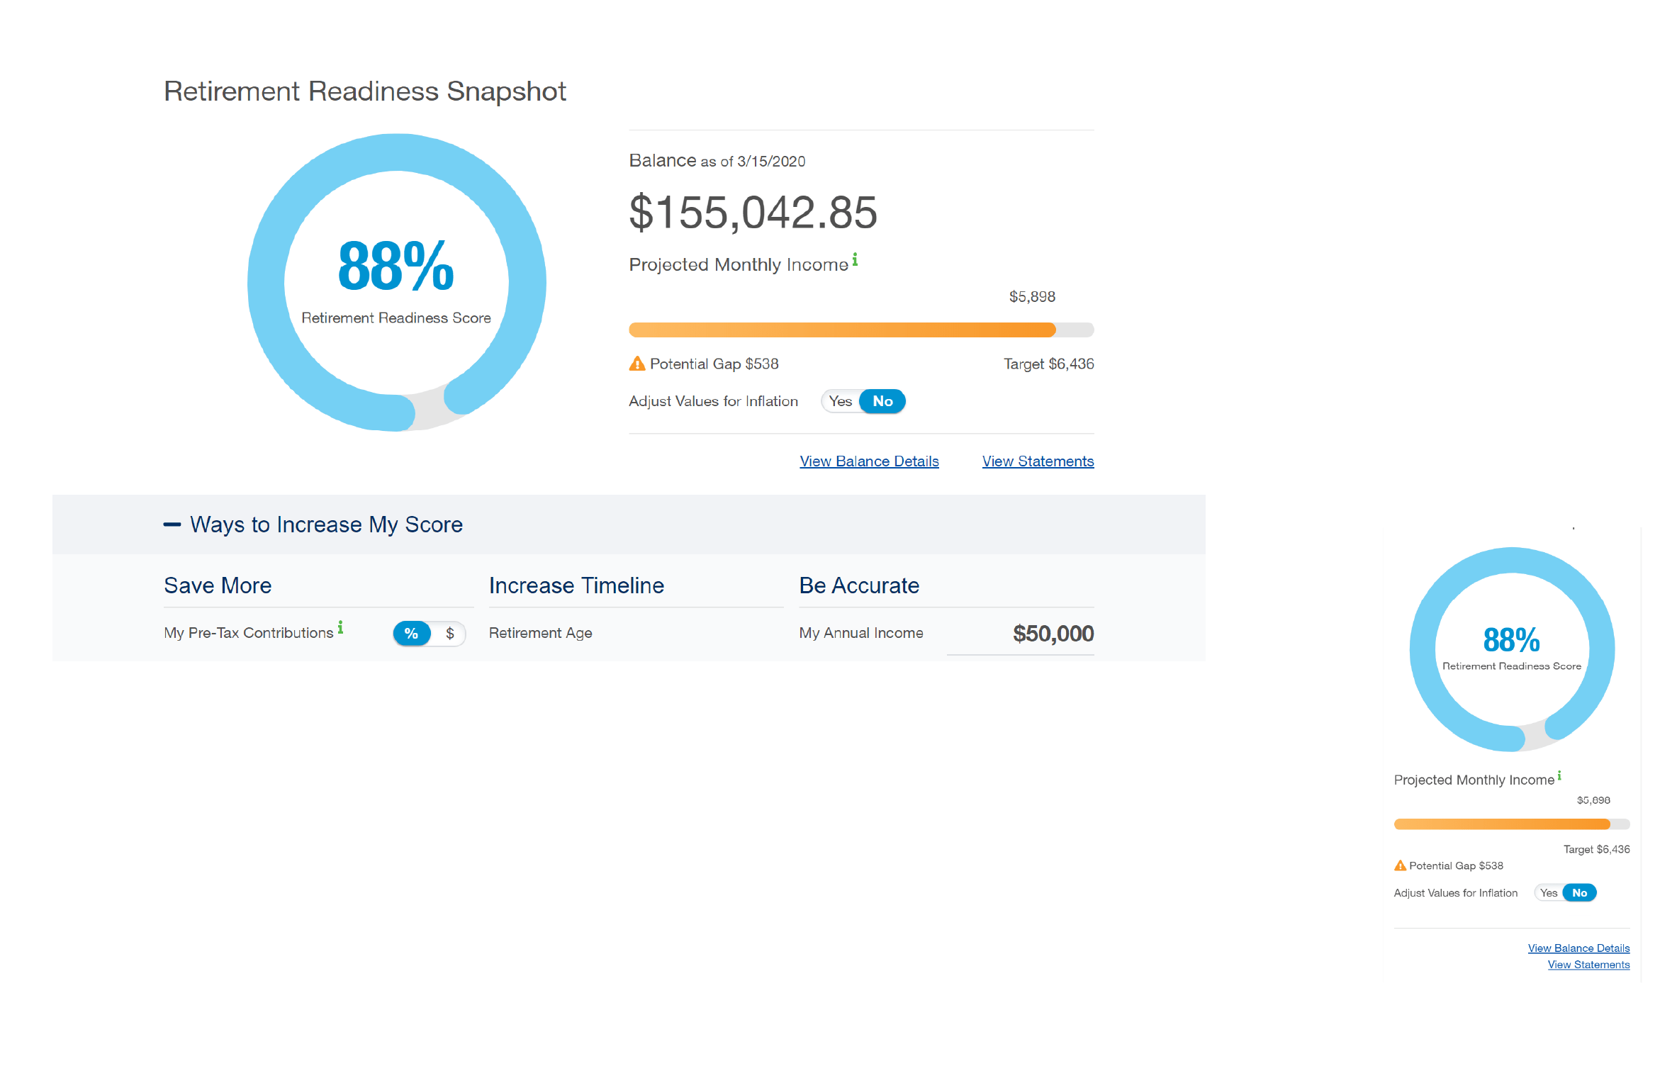
Are You Ready For Retirement
Retirement Readiness Snapshot at standard.com/login
Notes:
The Standard has a personalized online tool you can use called the Retirement Readiness Snapshot.
Just log into your Personal Savings Center, where you can manage your account online, and this tool
can help you calculate if you’re on track.

Slide 6
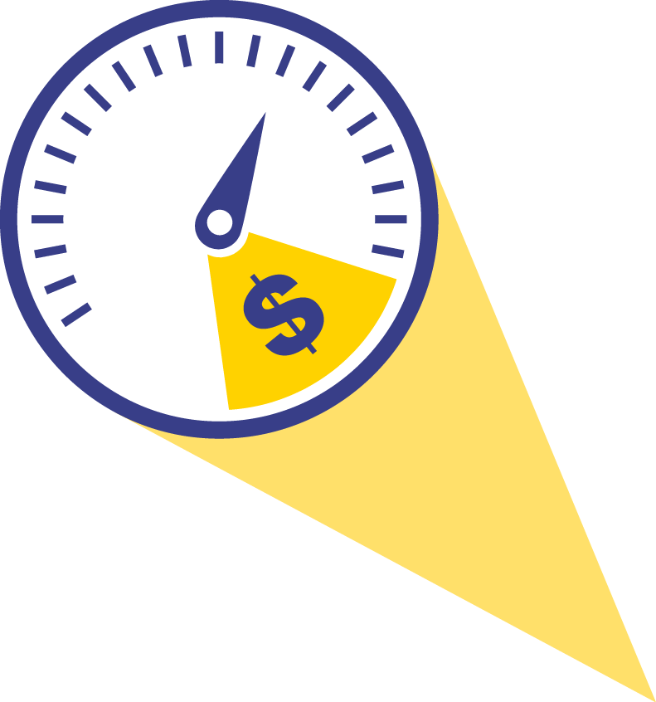
If You Need to Catch Up on Saving
Scale Back Expenses
Small Increase in Savings Now, Bigger Balance Later
ADDITIONAL GROWTH OVER TIME
Contribution
Increase
10
YEARS
20
YEARS
30
YEARS
40
YEARS
1%
($29.17 monthly)
$5,049
$15,195
$35,587
$76,566
5%
($145.83 monthly)
$25,241
$75,967
$177,908
$382,777
This example is hypothetical and for illustrative purposes only and is not indicative of the performance of any specific investment. Investments are subject to market risk and fluctuate in value. All contribution amounts are based on a $35,000 annual salary and assume an annual rate of return of 7% compounded monthly.
Notes:
You might realize your retirement savings aren’t on track to meet the retirement needs we just calculated.
If so, there are a few ways to get up to speed.
Scaling back spending is a smart step, especially on big expenses, such as housing. A less expensive home can result in fewer maintenance costs, lower mortgage or rent payments, and lower taxes.
And, of course, increase what you put into savings.
Receive a pay increase? Put it into your retirement savings.
This chart shows how every little bit can make a difference.

Slide 7
When to Take Social Security
RETIREMENT AGE AND SOCIAL SECURITY BENEFITS
TIME
AGE
EXPECTED
EARLY START
62
75% of benefits
EARLY START
63
80% of benefits
EARLY START
64
86.7% of benefits
EARLY START
65
93.3% of benefits
FULL RETIREMENT
66 - 67*
100% of benefits
*Full retirement age is dependent on what year you were born. This table is a general guide. The Social Security Administration can give you a more accurate figure.
DELAYED BENEFIT START
67 - 70
Varies by individual’s age
(up to 8% more per year)
Notes:
Social Security is another source of income you can collect throughout your retirement, but there are pros and cons to consider when deciding to start collecting.
If you start collecting benefits at age 62, you’ll only get 75% of your benefits.
If you wait until you’re 67, you’ll collect full benefits. And if you wait to collect until after age 67, your benefits will increase even more.

Slide 8
Factoring in Life Span
Average Life Expectancy
65-YEAR-OLD
WOMAN
86.5 YEARS
65-YEAR-OLD
MAN
84
YEARS
Notes:
There are a few other factors you need to plan for in order to know if your retirement savings are on track.
One is life span. If there’s a history of longevity in your family, you may want to start collecting Social Security later and consider withdrawing less from your savings so you’ll have enough money to last your lifetime..
According to the Social Security Administration, the current average life expectancy of a 65-year-old woman is 86.5 years; and for a 65-year-old man it’s 84 years.
You’ll need to understand how long your money needs to last you after you retire.

Slide 9
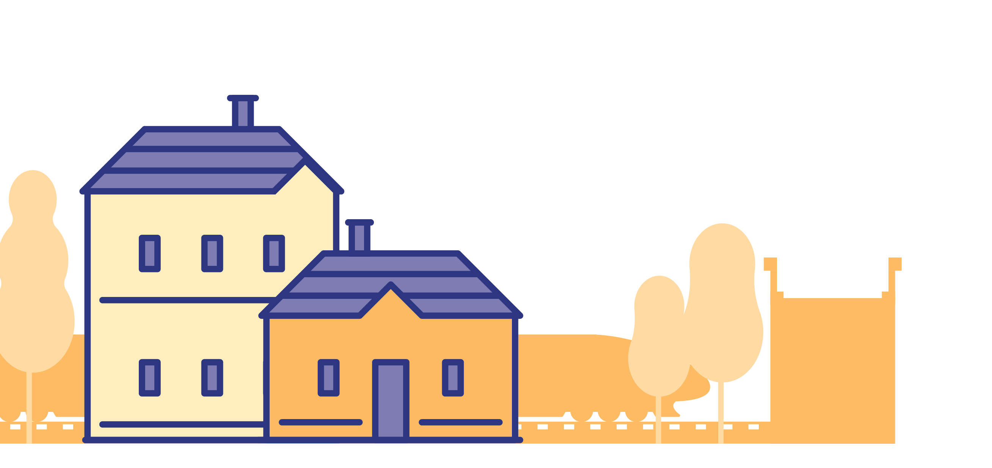
Don’t Forget About Inflation
Between 2000 and 2018, inflation averaged just over 2%*
At that rate over 25 years prices would nearly double.
COST OF LIVING
2X
IN 25 YEARS
$$
COST OF LIVING
NOW
$
*U.S. Bureau of Labor Statistics. Based on the Consumer Price Index.
Notes:
Another factor is inflation.
Your living costs will go up because of inflation.
If your retirement savings doesn’t grow at the same rate as inflation, you’ll have less to spend on things you need.
Between 2000 and 2018, inflation averaged just over 2%.
At that rate, over a retirement of 25 years, the cost of living and the prices of goods could effectively double.

Slide 10
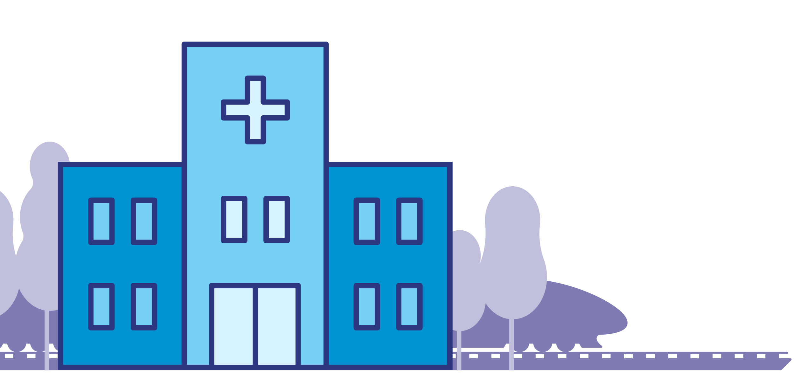
Factoring in Medical Expenses
5% increase in health care costs per year
HEALTHCARE COSTS
FOR A HEALTHY 65-YEAR-OLD COUPLE
+5%
+5%
+5%
+5%
$363,946
Retirement Year:
2020
2021
2022
2023
2024
Source: Healthview Services: 2018 Retirement Healthcare Costs Data Report
Notes:
Medical costs can go up 5% every year. What does this mean as you plan for retirement?
You’ll need to plan for this increase in health care costs per year throughout retirement.
According to HealthView Services, the total projected lifetime healthcare costs for a healthy 65-year-old couple retiring this year are expected to be $363,946.

Slide 11
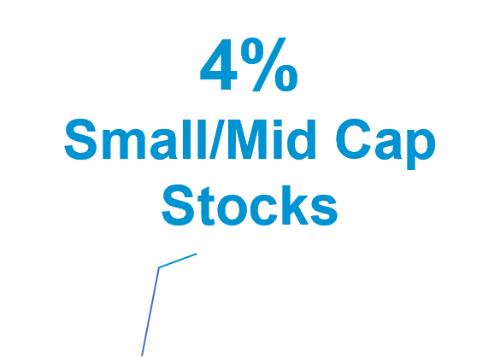
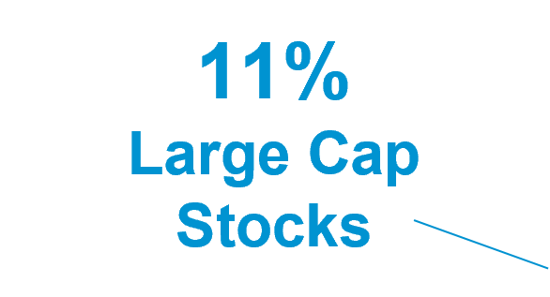
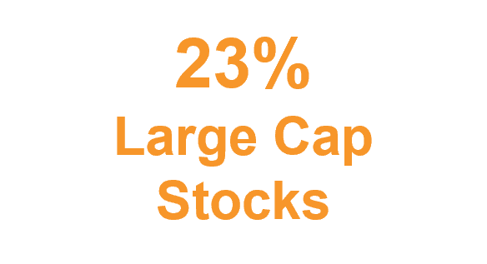
Choosing the Right Way to Invest
Portfolio 1
Portfolio 2
Conservative
Moderately
Conservative
Choose a mix of investments that fit your:
• Retirement age
• Situation
• Comfort with risk
Notes:
After you've determined how much money you need in retirement, you’ll need to look at how best to invest your savings to help you get to your goal.
Choosing the right way to invest is a key part of staying on track to retirement. A key strategy should be to earn steady returns as you age.
Different investments tend to do better in different market conditions.
For instance, stocks may take off while bonds suffer and vice versa. You can help balance that risk by choosing a mix of investments that fit your retirement age, situation and comfort with risk.

Slide 12
Ways to Make Your Money Last
Extend your benefits
Work during retirement
Have a cushion
Withdraw at a safe rate: 4%
Notes:
Something many people forget to plan for is how to make their money last in retirement.
Here are a few guidelines that can help:
Think about waiting a few years before retiring so your savings can grow and Social Security benefits can increase.
Consider if you can support yourself with a part-time job during retirement.
Keep some of your savings in cash or other investments that you can easily turn to during market swings. You don’t want to withdraw your savings during downturns in the market.
Plan to withdraw only 4% of your assets in a given year.

Slide 13
Making the Most of Retirement Accounts
Rules About Withdrawals:
Ages 55 to 59½: take money out of your 401(k) or 403(b) plan without penalty
Age 59½: Withdraw from IRAs and retirement plan without paying a penalty
Age 73: Required to withdraw a minimum amount
Notes:
As you approach retirement, it's good to think about factors such as if you want to keep your savings in your employer’s retirement plan, when to take withdrawals, and planning for taxes. These will help ensure you're taking steps that are best for your needs.
At certain ages you’ll be able to — or be required to — take withdrawals from your pre-tax retirement accounts. Keep in mind you may need to also pay taxes on pre-tax savings and earnings you withdraw. It can vary based on your income, filing status and other factors.
Here are some of the rules:
If you leave your job between the ages of 55 and 59½, you can take money out of your 401(k) or 403(b) plan without penalty, although a few restrictions do apply.
After 59½: You can withdraw money from your retirement plan or IRA without paying the early withdrawal penalty, whether you’re still working or not.
At age 73: If you have stopped working or are an owner of the company sponsoring the retirement plan, you are required to withdraw a minimum amount from your retirement plan or traditional IRA, or you will pay penalties.
If you’re lucky enough to have a pension or annuities, they will have different withdrawal requirements.

Slide 14
Checklist
Set a retirement age goal
Catch up on saving
Look at Social Security benefits
Factor in lifespan, inflation and medical expenses
Go to Personal Savings Center at standard.com/login
Notes:
We’ve covered a lot in this discussion and, of course, there’s always more to discuss.
Here’s a quick checklist to help you:
Set a retirement age goal, and factor in retirement spending needs and income levels.
Catch up on saving by considering lifestyle changes and saving more now, if you can.
Look at Social Security benefits and remember benefits can increase the longer you wait.
Factor in lifespan, inflation and medical expenses that can result in more spending and depleted savings.
Remember that you can always go online to Personal Savings Center at standard.com/login to find tools to help you plan and to change how much you save.

Slide 15
Questions
Notes:
[Option for Q&A session]

Slide 16
Disclosures
The Standard, 1100 SW Sixth Avenue, Portland, OR 97204 | standard.com/retirement
Past performance is no guarantee of future results. Current performance may be higher or lower. Investment performance includes capital appreciation, if any, plus reinvested dividends and capital gains. The investment return and principal value will fluctuate and your shares, when redeemed, may be worth more or less than the original investment. The most up-to-date performance, current as of the last day of the previous calendar month, may be obtained by calling 877.805.1127.
RP 21437 (9/23)

