Slide 1
Welcome
Con el pensamiento de jubilarse
CAMINO HACIA LA
JUBILACIÓN
Notes:
Welcome.
You’ve probably already thought about retirement and done some planning, but most of us could also use a bit more guidance to make sure our retirement plan is on track. What are the factors that should be considered?
Today we're going to help you by looking at some options when thinking about retirement:
• Setting a retirement age goal
• Catching up on saving
• Looking at Social Security benefits
• Considering life span, inflation and medical expenses
• Choosing the right mix of investments
• Managing your plan
Let’s get started.

Slide 2
Presentaciones
NOMBRE DEL
GERENTE COMERCIAL
Gerente comercial
Notes:
[Option for speaker introduction]

Slide 3
Su itinerario para la jubilación
65 AÑOS
66 AÑOS
67 AÑOS
¿Cuánto dinero gastará en la jubilación?
EJEMPLO PARA UN INGRESO ANUAL DE $60,000
75% - 85%
DE SUS INGRESOS ACTUALES
$45,000 a $50,000
$60,000
0
25%
50%
75%
100%
Espere gastar de $45,000 a $50,000 por año de jubilación.
Notes:
When planning for retirement, you’ll need to figure out how much money you’ll be spending in retirement.
Many financial planners say most retirees will spend between 75% to 85% of their current income in retirement.
So, if you spend $60,000 a year while working, you can expect to spend about $45,000 to $50,000 a year in retirement.
You’ll need money for rent or mortgage, food and necessities, utilities, and other expenses.
Taxes, debt, medical expenses and other costs could make the amount you will spend more or less.

Slide 4
Su itinerario para la jubilación
65 AÑOS
66 AÑOS
67 AÑOS
¿Qué cantidad de ingresos puede esperar?
ESTABLECER UN OBJETIVO DE JUBILACIÓN
4%
EJEMPLO DE UN OBJETIVO DE $1 MILLÓN EN AHORROS PARA LA JUBILACIÓN
RETIRAR DE MANERA SEGURA $40,000 POR AÑO
DE SUS AHORROS
CADA AÑO
La edad en la que tendrá suficientes ahorros para cubrir los gastos de jubilación.
Esto asume una tasa de rentabilidad anual del 4%.
Notes:
The second question to answer is: How much income can you expect in retirement?
Retirement income can come from your retirement savings, social security or other sources, which we’ll cover in a bit.
A rule of thumb is you can draw about 4% of your savings each year and still maintain your savings thorough retirement.
For example, if you have $1 million saved, you should be able to withdraw $40,000 a year and your savings will last throughout retirement.
You should only retire when you have enough savings and benefits to cover your retirement spending needs. When you can reach that savings goal will be your target retirement age.
To set a retirement age, you’ll need to calculate when you’ll have enough savings to regularly withdraw the amount you’ll need to live on. If you’ll have other sources of income in retirement, you can rely a bit less on your savings.

Slide 5
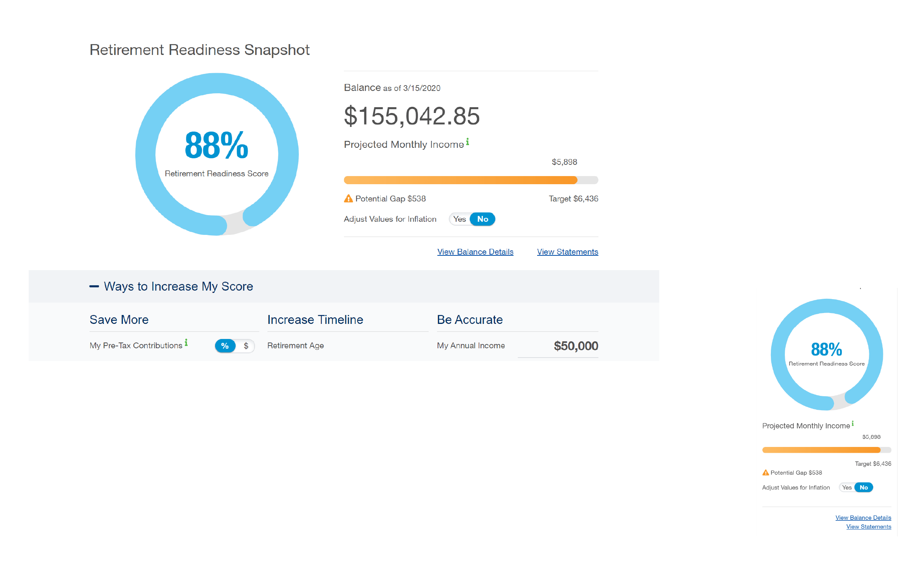
¿Está listo para jubilarse?
Retirement Readiness Snapshot [Imagen de preparación para la jubilación en] standard.com/login
Notes:
The Standard has a personalized online tool you can use called the Retirement Readiness Snapshot.
Just log into your Personal Savings Center, where you can manage your account online, and this tool
can help you calculate if you’re on track.

Slide 6
Si necesita ponerse al día con los ahorros
Reduzca los gastos
Pequeño aumento en los ahorros ahora, mayor saldo después.
CRECIMIENTO EXTRA CON EL PASO DEL TIEMPO
Aumento de
la aportación
10
AÑOS
20
AÑOS
30
AÑOS
40
AÑOS
1%
($29.17 mensual)
$5,049
$15,195
$35,587
$76,566
5%
($145.83 mensual)
$25,241
$75,967
$177,908
$382,777
Este ejemplo es hipotético y tiene únicamente fines ilustrativos, y no representa el rendimiento de ninguna inversión específica. Las inversiones están sujetas al riesgo de mercado y su valor es fluctuante. Todas las aportaciones se basan en un sueldo anual de $35,000 y asumen una tasa de rentabilidad anual del 7% calculado mensualmente.
Notes:
You might realize your retirement savings aren’t on track to meet the retirement needs we just calculated.
If so, there are a few ways to get up to speed.
Scaling back spending is a smart step, especially on big expenses, such as housing. A less expensive home can result in fewer maintenance costs, lower mortgage or rent payments, and lower taxes.
And, of course, increase what you put into savings.
Receive a pay increase? Put it into your retirement savings.
This chart shows how every little bit can make a difference.

Slide 7
Cuándo cobrar el Seguro Social
EDAD DE JUBILACIÓN Y SUBSIDIOS DEL SEGURO SOCIAL
INICIO DE JUBILACIÓN
EDAD
PORCENTAJE PREVISTO
JUBILACIÓN TEMPRANA
62
75% de los subsidios
JUBILACIÓN TEMPRANA
63
80% de los subsidios
JUBILACIÓN TEMPRANA
64
86.7% de los subsidios
JUBILACIÓN TEMPRANA
65
93.3% de los subsidios
JUBILACIÓN PLENA
66 - 67*
100% de los subsidios
*La edad de jubilación plena depende del año en que nació. Esta tabla es una guía general. La Administración del Seguro Social puede proporcionarle un dato más preciso.
SUBSIDIOS DE JUBILACIÓN TARDÍA
67 - 70
Varía según la edad de la persona (hasta 8% más por año)
Notes:
Social Security is another source of income you can collect throughout your retirement, but there are pros and cons to consider when deciding to start collecting.
If you start collecting benefits at age 62, you’ll only get 75% of your benefits.
If you wait until you’re 67, you’ll collect full benefits. And if you wait to collect until after age 67, your benefits will increase even more.

Slide 8
Considerar la duración máxima de vida
Esperanza de vida promedio
MUJER DE
65 AÑOS
86.5 AÑOS
HOMBRE DE
65 AÑOS
84
AÑOS
Notes:
There are a few other factors you need to plan for in order to know if your retirement savings are on track.
One is life span. If there’s a history of longevity in your family, you may want to start collecting Social Security later and consider withdrawing less from your savings so you’ll have enough money to last your lifetime..
According to the Social Security Administration, the current average life expectancy of a 65-year-old woman is 86.5 years; and for a 65-year-old man it’s 84 years.
You’ll need to understand how long your money needs to last you after you retire.

Slide 9
No se olvide de la inflación
Entre 2000 y 2018, la inflación se situó en un promedio de un poco más del 2%*
Con esa tasa, a lo largo de 25 años, los precios casi se duplicarían.
COSTO DE VIDA
DUPLICADO
EN 25 AÑOS
$$
COSTO DE VIDA
AHORA
$
*Oficina de Estadísticas Laborales de Estados Unidos. Basados en el Índice de precios al consumidor
Notes:
Another factor is inflation.
Your living costs will go up because of inflation.
If your retirement savings doesn’t grow at the same rate as inflation, you’ll have less to spend on things you need.
Between 2000 and 2018, inflation averaged just over 2%.
At that rate, over a retirement of 25 years, the cost of living and the prices of goods could effectively double.

Slide 10
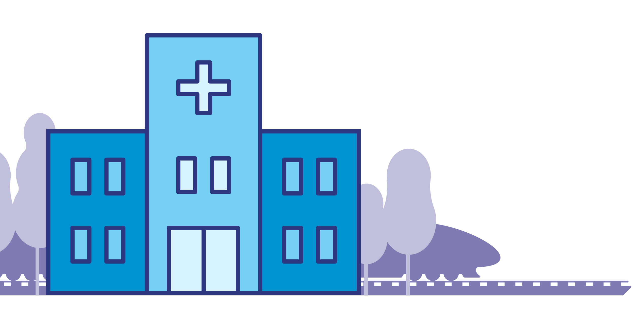
Considerar los gastos médicos
Aumento del 5% de los gastos de atención médica por año
GASTOS DE ATENCIÓN MÉDICA
PARA UNA PAREJA DE 65 AÑOS CON BUENA SALUD
+5%
+5%
+5%
+5%
$363,946
Año de jubilación:
2020
2021
2022
2023
2024
Fuente: HealthView Services: 2018 Retirement Healthcare Costs Data Report
Notes:
Medical costs can go up 5% every year. What does this mean as you plan for retirement?
You’ll need to plan for this increase in health care costs per year throughout retirement.
According to HealthView Services, the total projected lifetime healthcare costs for a healthy 65-year-old couple retiring this year are expected to be $363,946.

Slide 11
Elegir la manera correcta de invertir
4%
Acciones de capitalización baja/media
7%
Acciones de capitalización baja/media
5%
Acciones internacionales
10%
Acciones internacionales
11%
Acciones
de capitalización alta
Cartera 1
Cartera 2
Conservador
50%
Bonos
Moderadamente
Conservador
40%
Bonos
23%
Acciones
de capitalización alta
30%
Equivalentes en efectivo
20%
Equivalentes en efectivo
Escoja una combinación de inversiones que se ajusten a su:
• Edad de jubilación
• Situación
• Comodidad con el riesgo
Notes:
After you've determined how much money you need in retirement, you’ll need to look at how best to invest your savings to help you get to your goal.
Choosing the right way to invest is a key part of staying on track to retirement. A key strategy should be to earn steady returns as you age.
Different investments tend to do better in different market conditions.
For instance, stocks may take off while bonds suffer and vice versa. You can help balance that risk by choosing a mix of investments that fit your retirement age, situation and comfort with risk.

Slide 12
Maneras de hacer que su dinero dure
Extender sus subsidios
Trabajar durante la jubilación
Tener un colchón financiero
Hacer retiros a una tasa sostenible: 4%.
Notes:
Something many people forget to plan for is how to make their money last in retirement.
Here are a few guidelines that can help:
Think about waiting a few years before retiring so your savings can grow and Social Security benefits can increase.
Consider if you can support yourself with a part-time job during retirement.
Keep some of your savings in cash or other investments that you can easily turn to during market swings. You don’t want to withdraw your savings during downturns in the market.
Plan to withdraw only 4% of your assets in a given year.

Slide 13
Aprovechar al máximo las cuentas de jubilación
Reglas sobre los retiros:
De los 55 a los 59 años y 6 meses: retire dinero de su plan 401(k) o 403(b) sin multa
A los 59 años y 6 meses: retire de su Cuenta de jubilación individual (Individual Retirement Account (IRA, por sus siglas en inglés)) y su plan de jubilación sin pagar una multa
A los 73 años: se le solicita que retire una cantidad mínima.
Notes:
As you approach retirement, it's good to think about factors such as if you want to keep your savings in your employer’s retirement plan, when to take withdrawals, and planning for taxes. These will help ensure you're taking steps that are best for your needs.
At certain ages you’ll be able to — or be required to — take withdrawals from your pre-tax retirement accounts. Keep in mind you may need to also pay taxes on pre-tax savings and earnings you withdraw. It can vary based on your income, filing status and other factors.
Here are some of the rules:
If you leave your job between the ages of 55 and 59½, you can take money out of your 401(k) or 403(b) plan without penalty, although a few restrictions do apply.
After 59½: You can withdraw money from your retirement plan or IRA without paying the early withdrawal penalty, whether you’re still working or not.
At age 73: If you have stopped working or are an owner of the company sponsoring the retirement plan, you are required to withdraw a minimum amount from your retirement plan or traditional IRA, or you will pay penalties.
If you’re lucky enough to have a pension or annuities, they will have different withdrawal requirements.

Slide 14
Lista de verificación
Establecer un objetivo de edad de jubilación
Ponerse al día con los ahorros
Consulte los subsidios del Seguro Social
Considerar la duración máxima de vida, la inflación y los gastos médicos
Visite el Personal Savings Center [Centro de ahorros personales] en www.standard.com/login.
Notes:
We’ve covered a lot in this discussion and, of course, there’s always more to discuss.
Here’s a quick checklist to help you:
Set a retirement age goal, and factor in retirement spending needs and income levels.
Catch up on saving by considering lifestyle changes and saving more now, if you can.
Look at Social Security benefits and remember benefits can increase the longer you wait.
Factor in lifespan, inflation and medical expenses that can result in more spending and depleted savings.
Remember that you can always go online to Personal Savings Center at standard.com/login to find tools to help you plan and to change how much you save.

Slide 15
Preguntas
Notes:
[Option for Q&A session]

Slide 16
Conclusion
The Standard, 1100 SW Sixth Avenue, Portland, OR 97204 | standard.com/retirement
El rendimiento pasado no es garantía de resultados futuros. El rendimiento actual puede ser mayor o menor. El rendimiento de las inversiones incluye la apreciación de capital, si lo hubiera, más los dividendos reinvertidos y ganancias de capital. La rentabilidad de inversión y el valor principal fluctuarán, y sus acciones, cuando se redima, podrían valer más o menos que la inversión original. El rendimiento más actualizado, vigente al último día del mes calendario anterior, pueden obtenerse llamando al 877.805.1127.
RP 21437-SPU (9/23)

